Slide 1
45 years old female
Presented with ATCP and headache from 1 month ago.
PMH: Unremarkable
DH: Some OTCs , LD for 6 months due to ovarian cysts.
BP: 145/90 mmHg. HR: 90 bpm

Slide 2
BP measurement

Slide 3
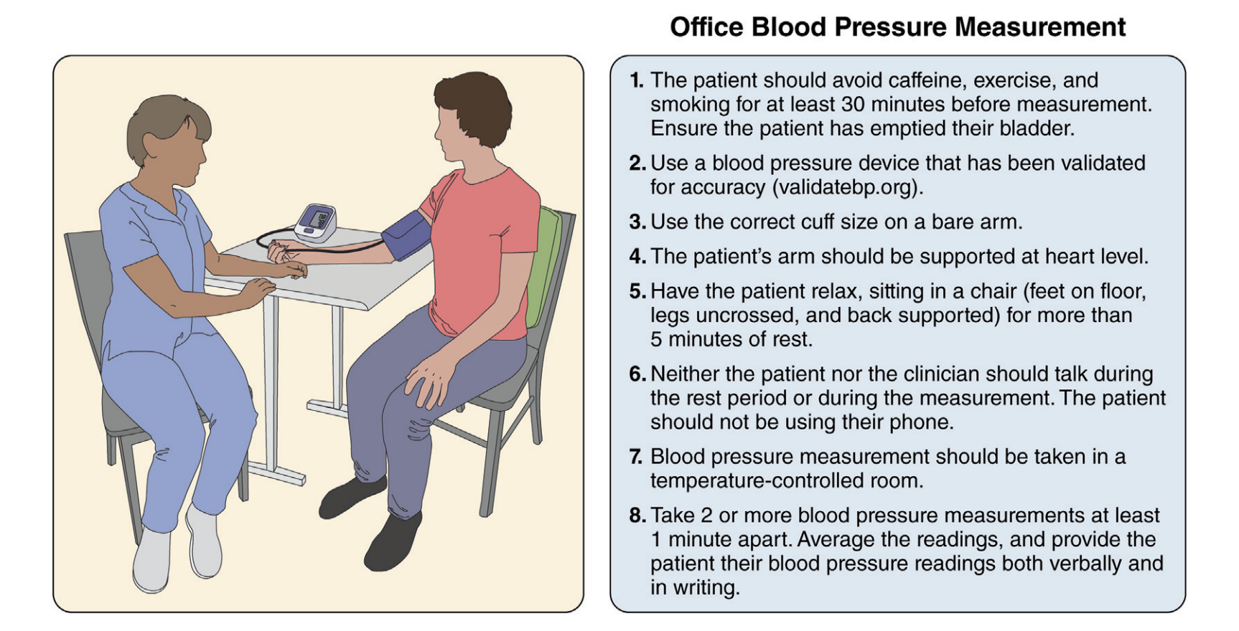

Slide 4
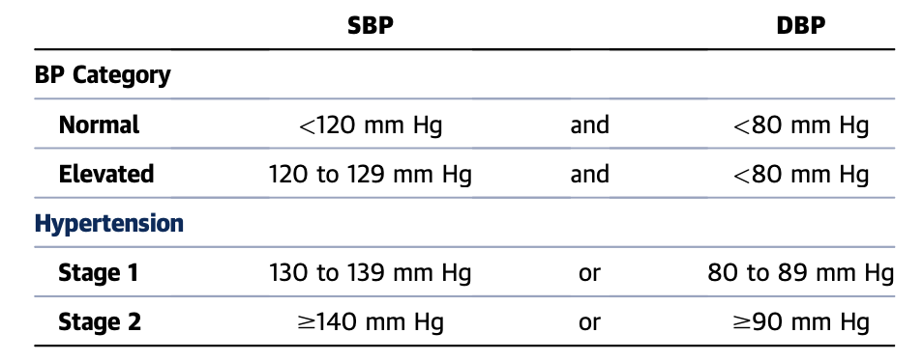

Slide 5
TARGET ORGAN DAMAGE
Left Ventricle Hypertrophy - LVH
Stroke or TIA
Chronic Kidney Disease- CKD
MI or CAD

Slide 6
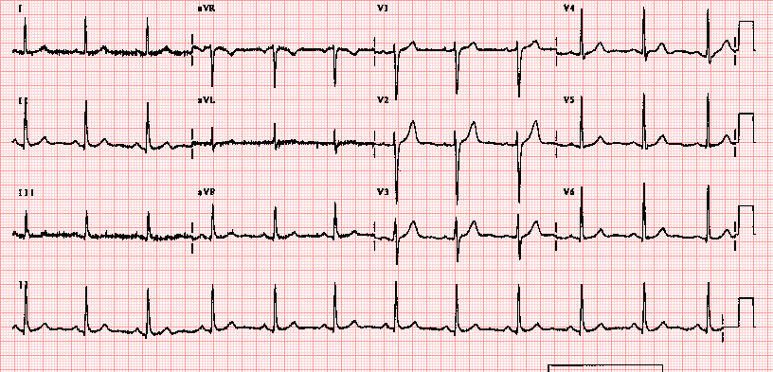

Slide 7
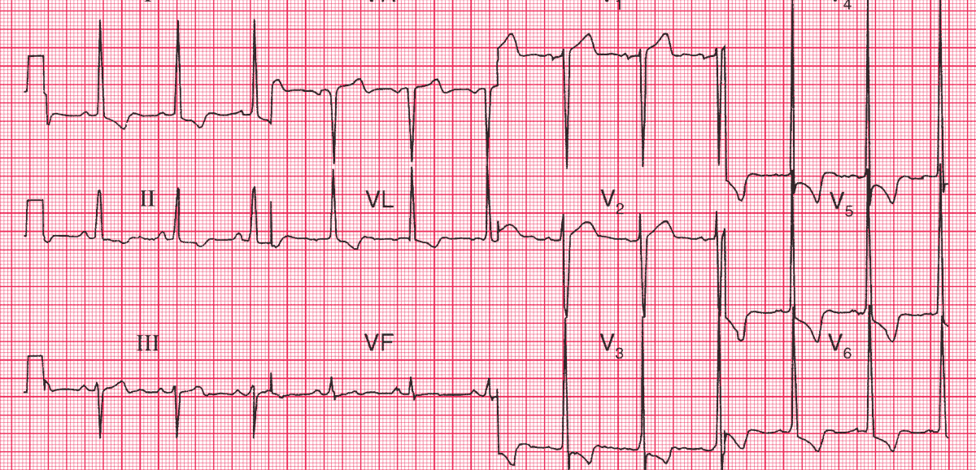

Slide 8
Out of office BP monitoring

Slide 9
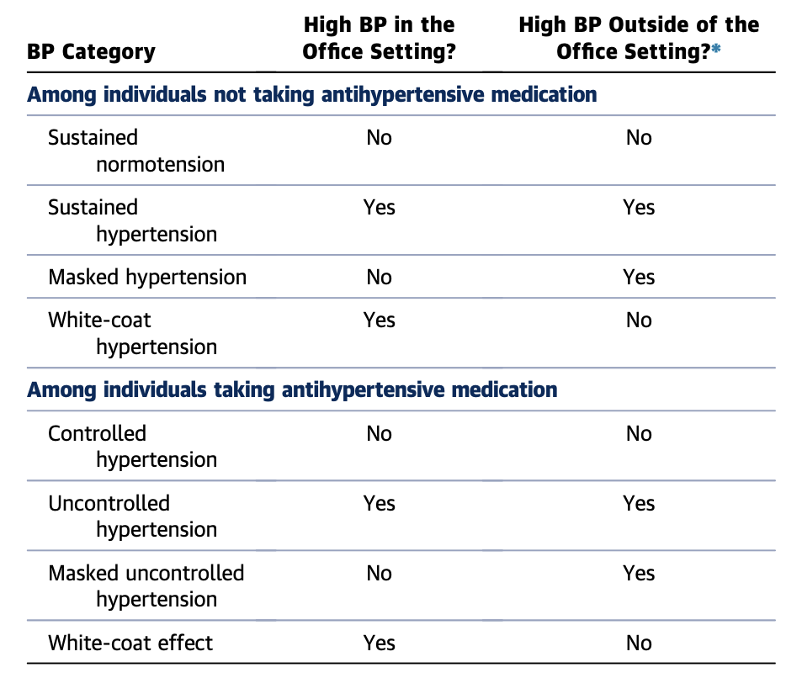

Slide 10
Home BP monitoring
HBPM

Slide 11
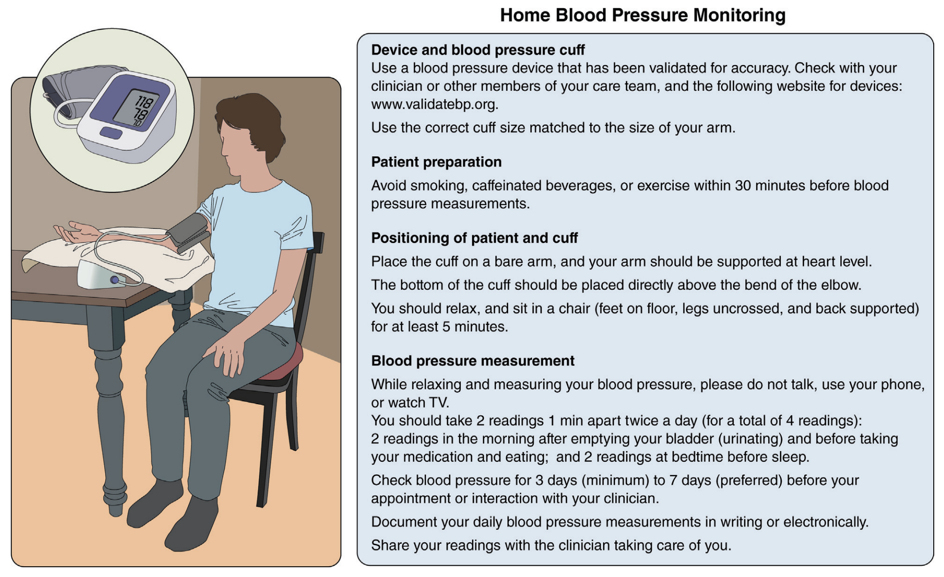

Slide 12
24 hr BP Holter Monitorin
ABPM

Slide 13
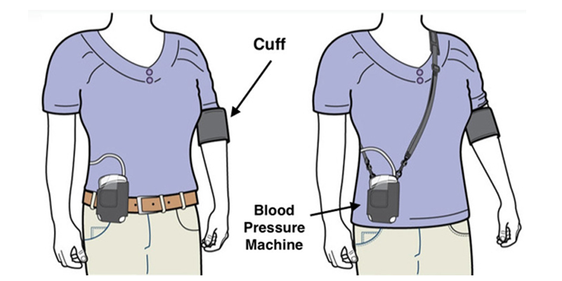

Slide 14
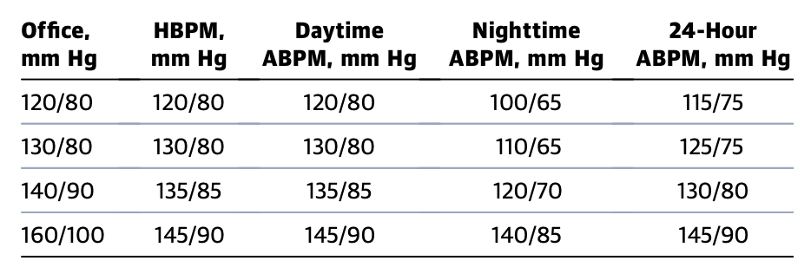

Slide 15
HBPM of this Patient was within normal limits

Slide 16


Slide 17
66 years old man
Presented with compresive retrosternal chest pain from a week ago.
PMH: DM for 10 years on Insulin
DH: ASA, Atorvastatin , Insulin.
SH: Smoker 30 p/y
BP: 125/80 mmHg. HR: 80 bpm

Slide 18
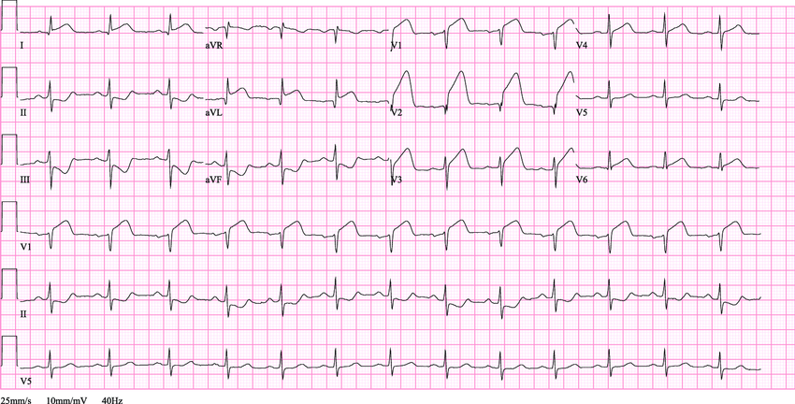

Slide 19
hs-TnI > 5000 ng/ml

Slide 21
56 years old man
Presented with frequent syncopes.
PMH: HTN , BPH , Parkinson disease
DH: ASA, Captopril, Prazosin , Levodopa
BP: 125/80 mmHg. HR: 80 bpm
Cardiac exam showed 3/6 murmur - crescendo - decrescendo and harsh at 2nd RICS

Slide 22
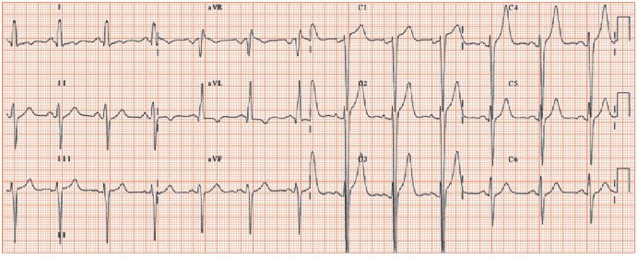

Slide 23
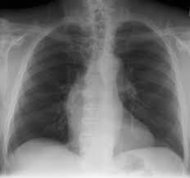

Slide 24


Slide 25
Innocent murmur
Soft
Systolic
Short
Sounds are Normal S1 & S2
Symptomless
Spescial tests are Normal , ECG and CXR
Standing/Sitting - varies with maneuvers

Slide 26
Echocardiography
Normal LV size and function
LVEF: 60%
Concentric LVH
Aortic valve PG:70 mmHg. MG: 45 mmHg
SPAP: 35 mmHg

Slide 28
75 years old woman
Presented with Dyspnea and lower legs edema
PMH: HTN , DM and hypothyroidism
DH: Amlodipin, losartan, spironolactone
BP: 165/95 mmHg. HR: 110 bpm
Cardiac exam showed tachycardia with S3 and S4
Lung exam showed fine rales.
Lower legs showed 3+ pitting edema

Slide 29
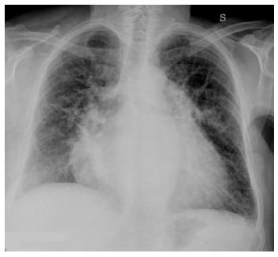

Slide 30
