Slide 1
HTN

Slide 2
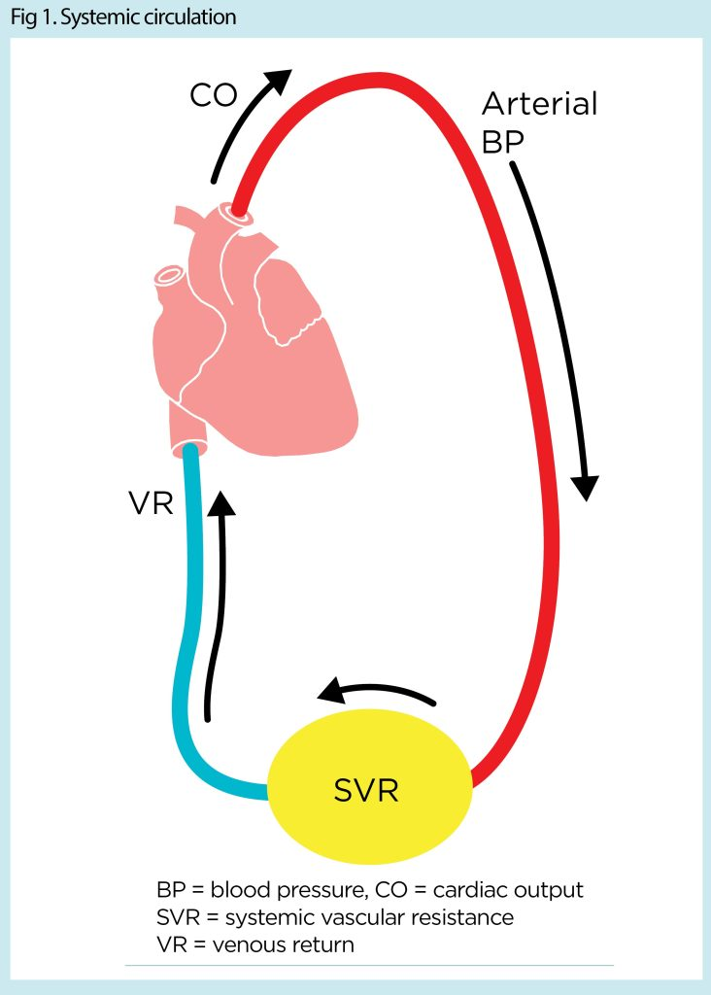
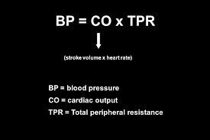

Slide 3
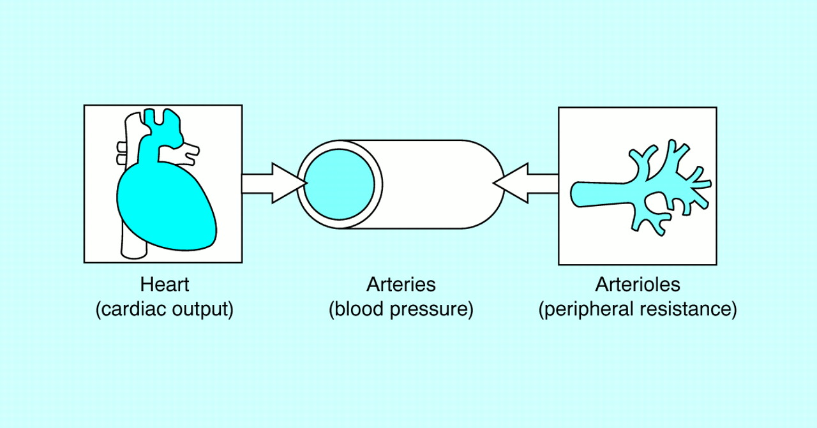

Slide 4
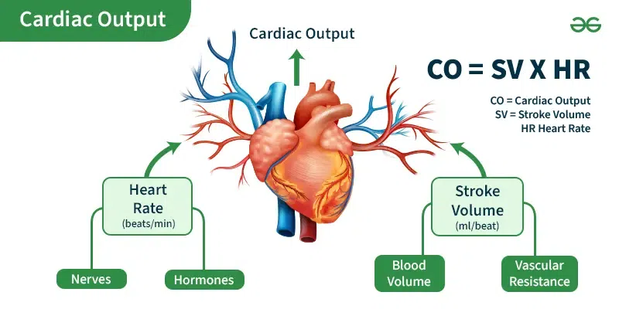

Slide 5
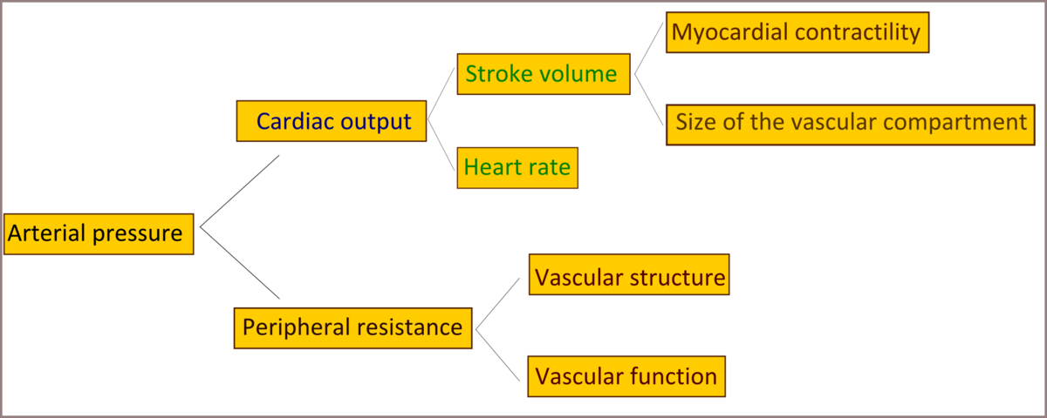

Slide 6



Slide 7
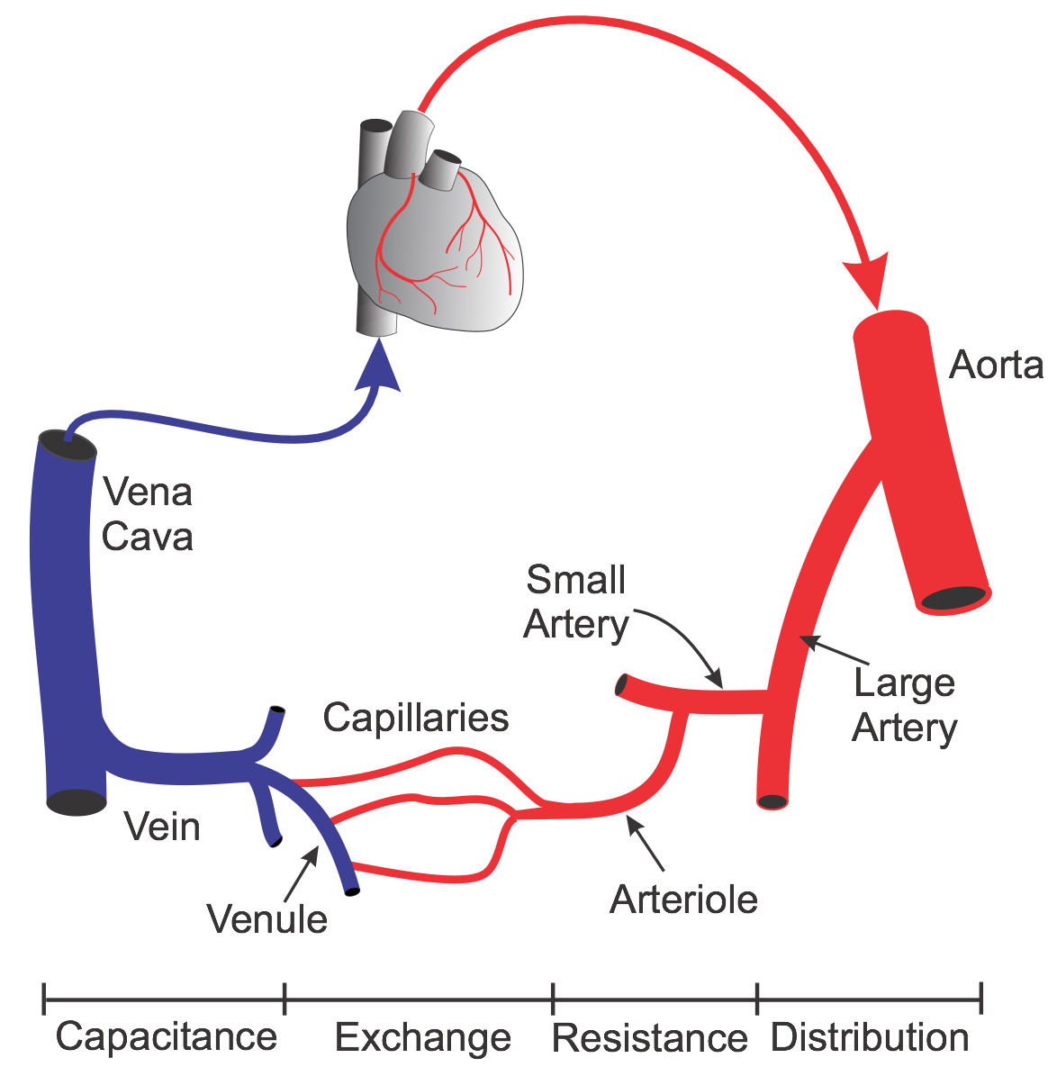

Slide 8
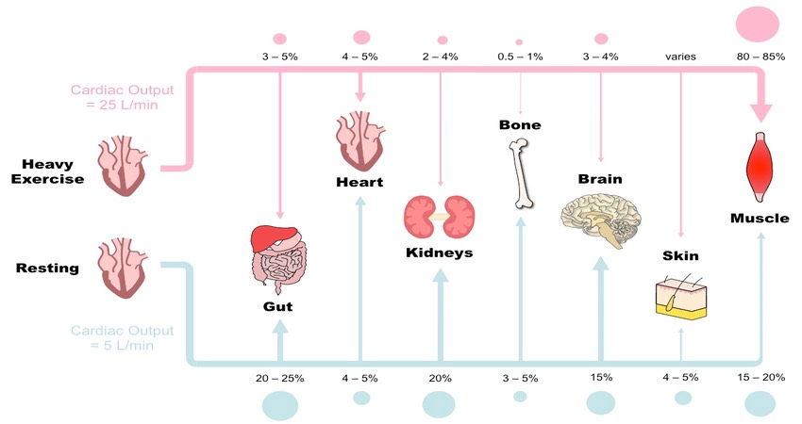

Slide 9
SBP
DBP

Slide 10
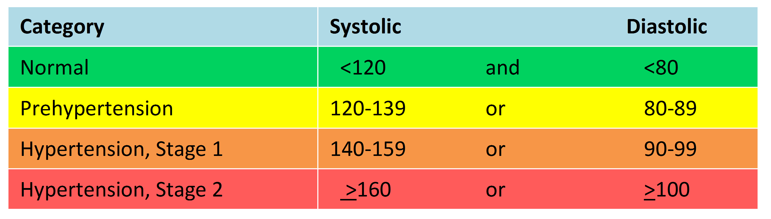

Slide 11
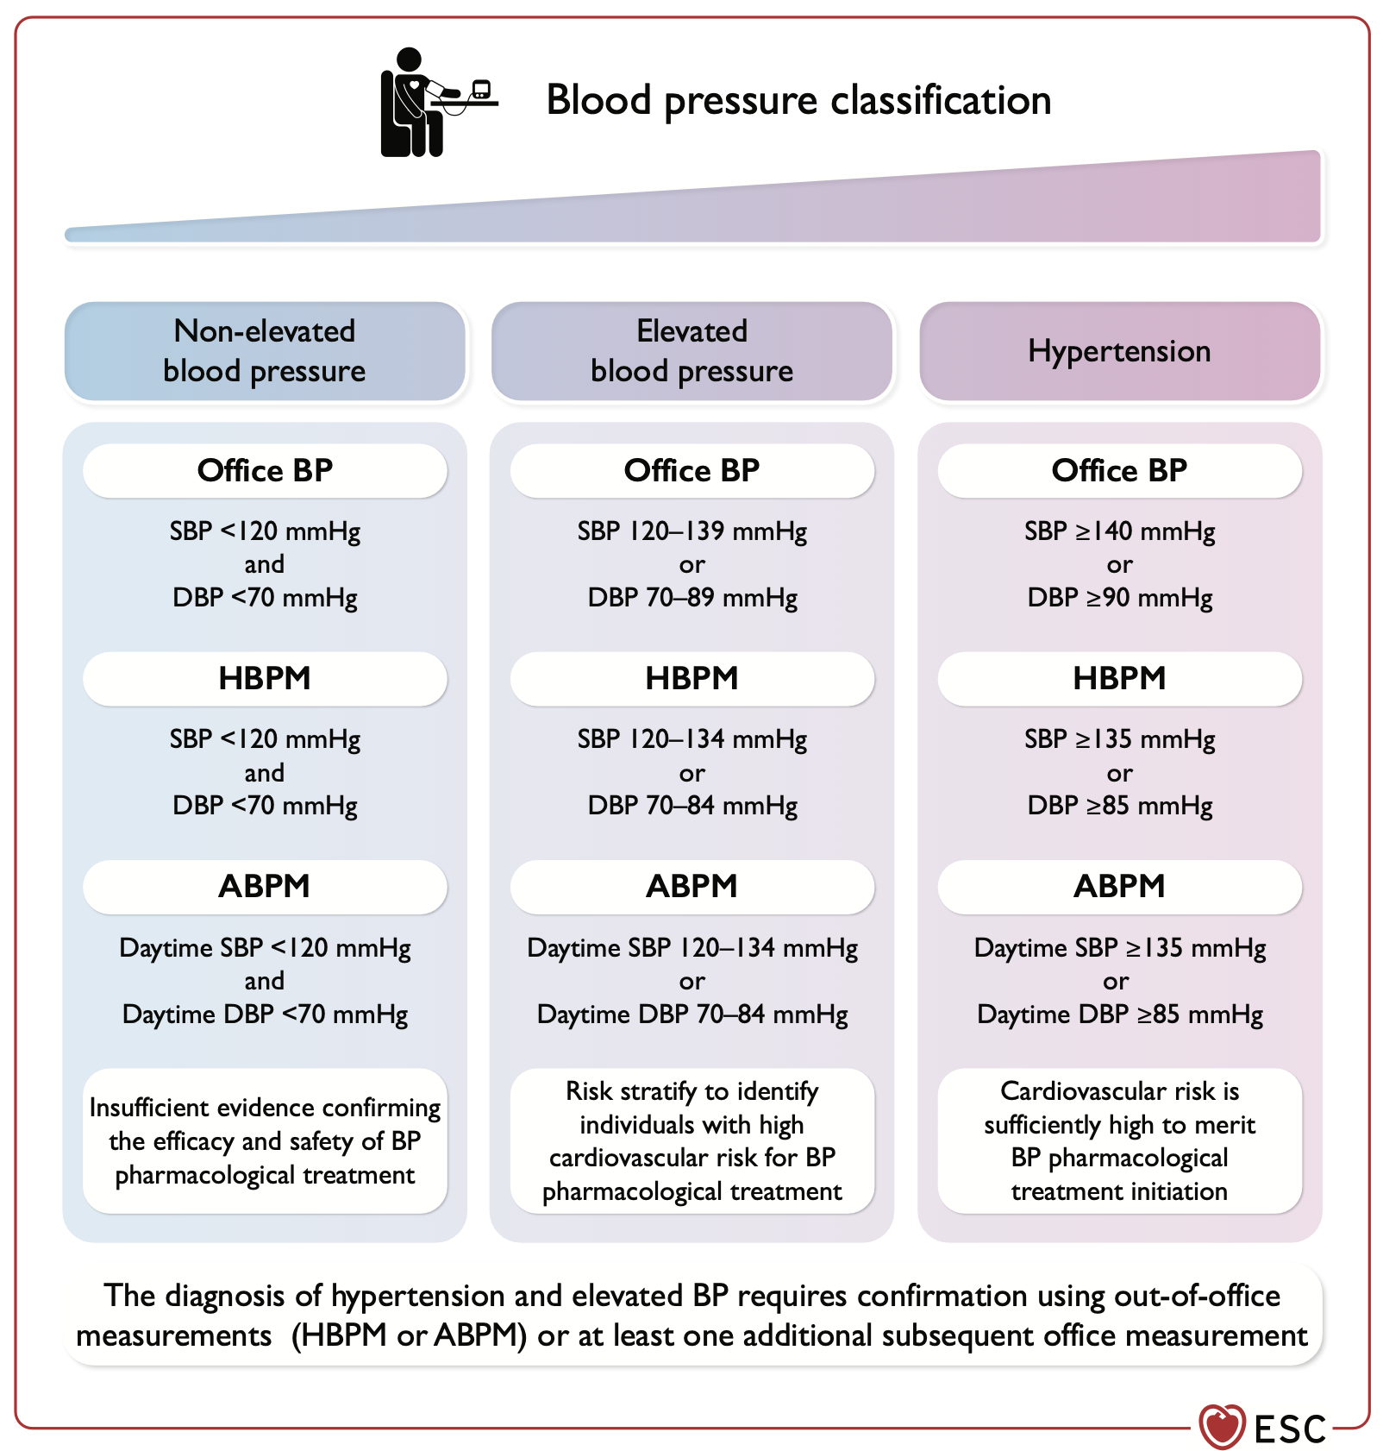

Slide 12
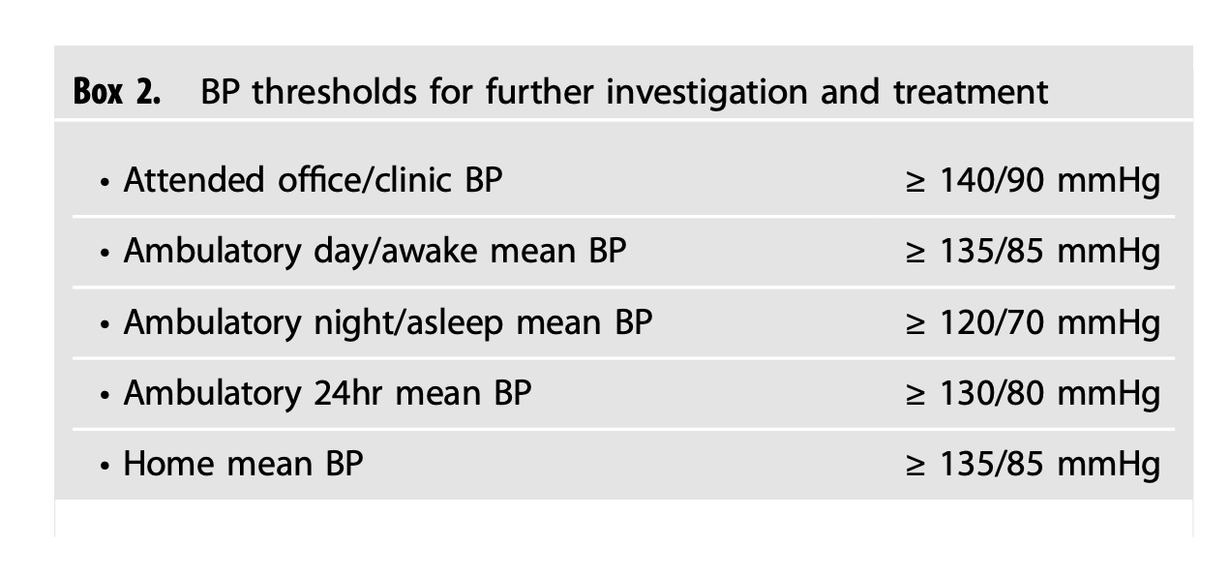

Slide 13
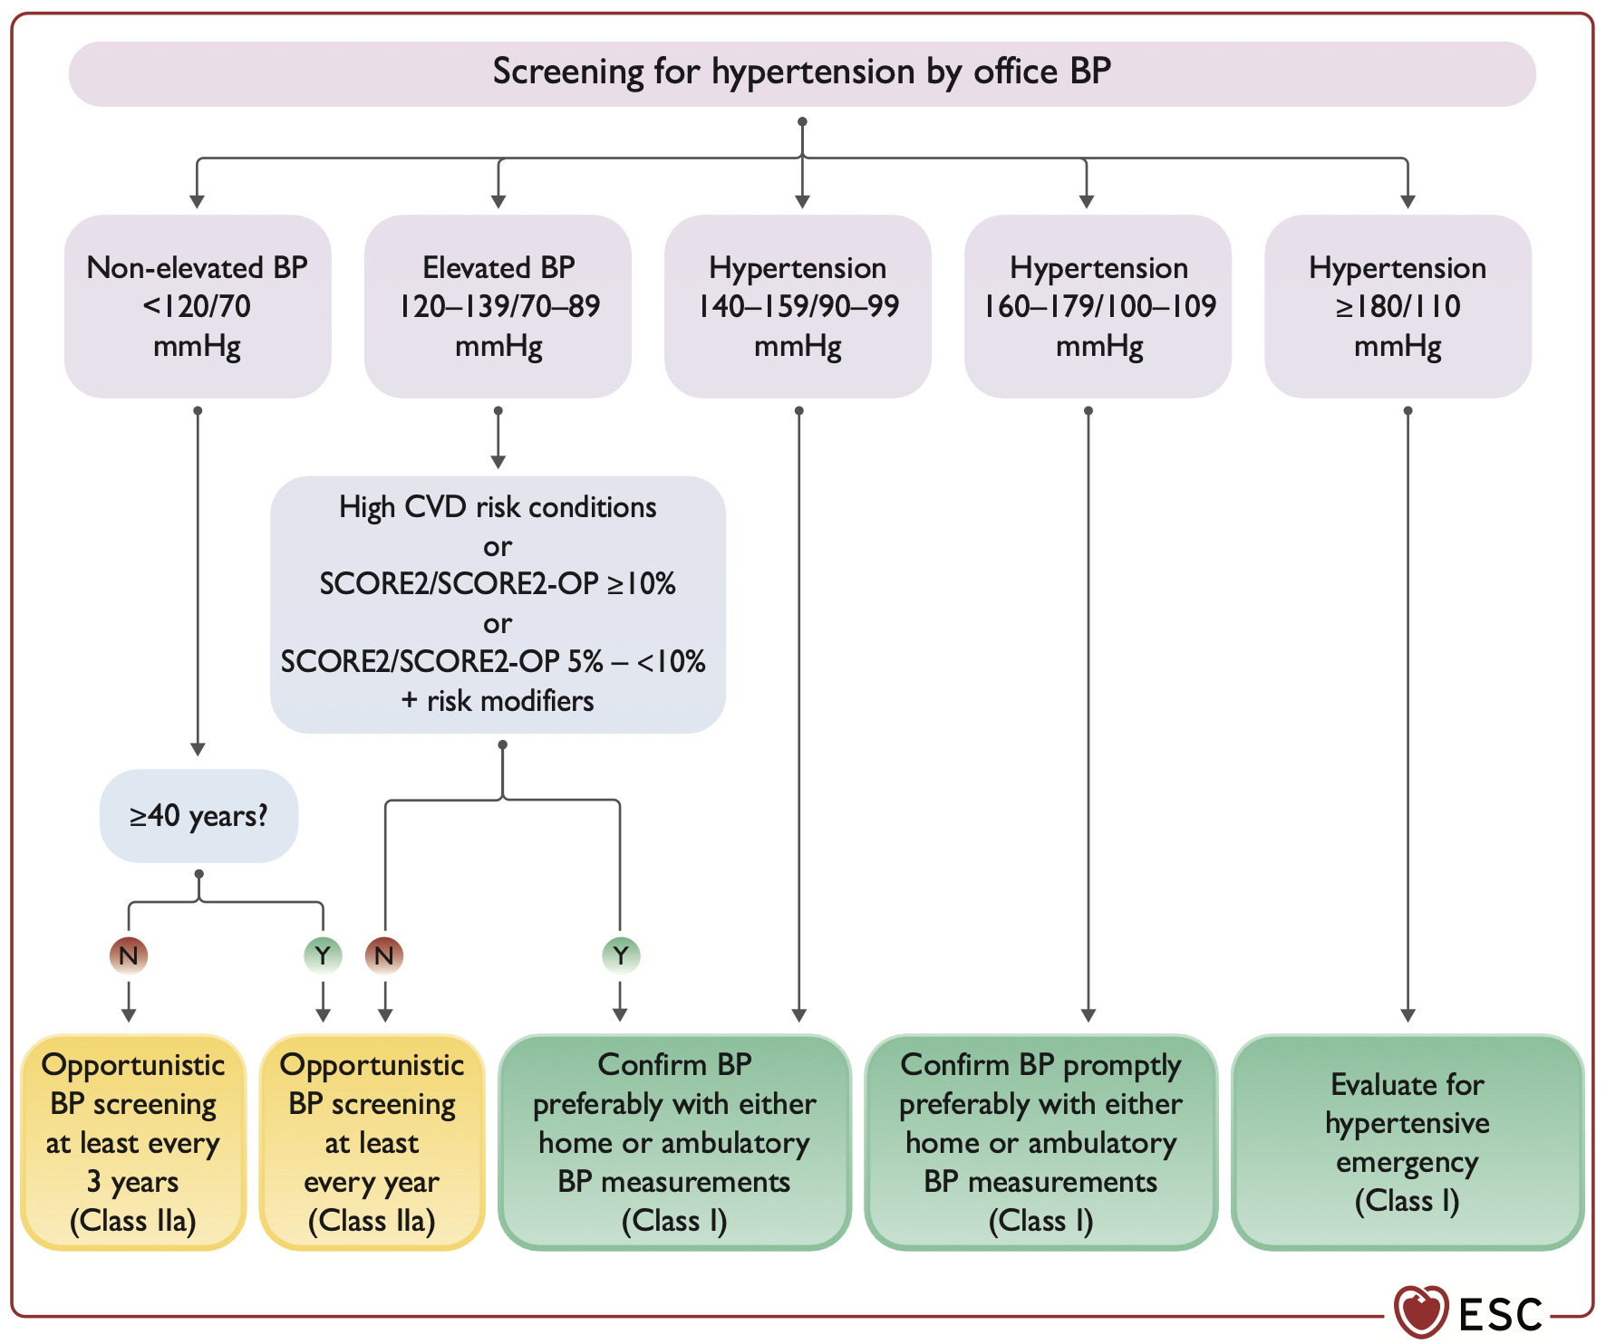

Slide 14
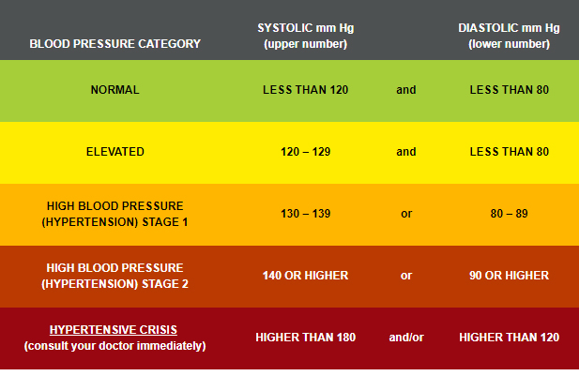

Slide 15
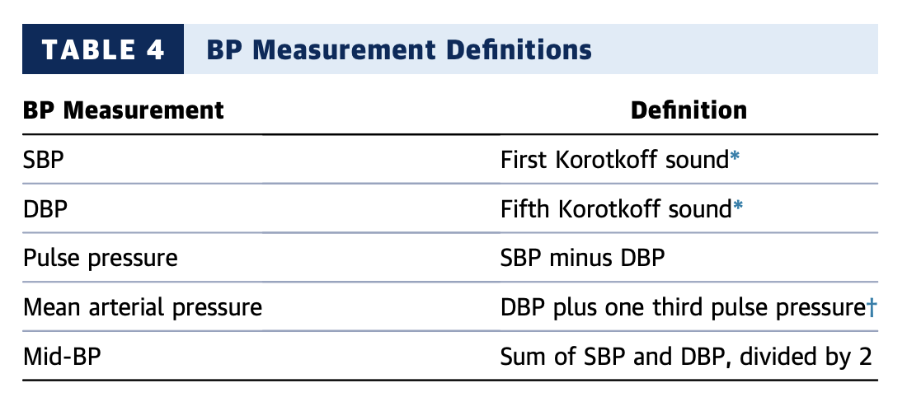
BP Components

Slide 16
۱- فشارخون، کشنده است.

Slide 17
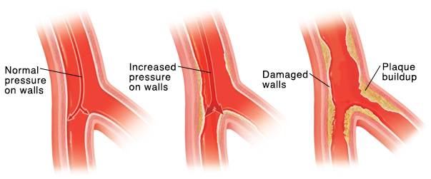
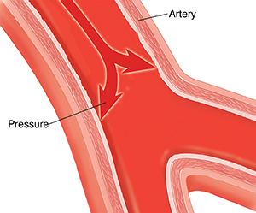
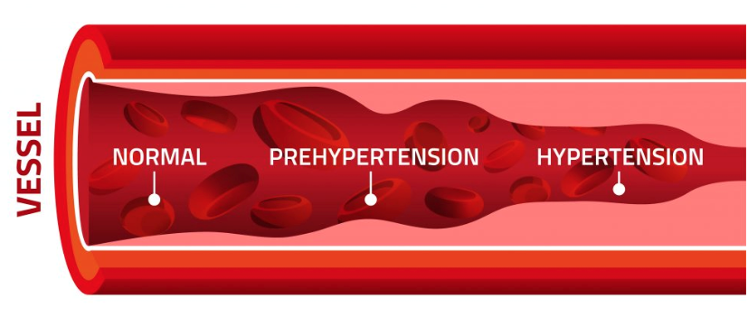

Slide 18
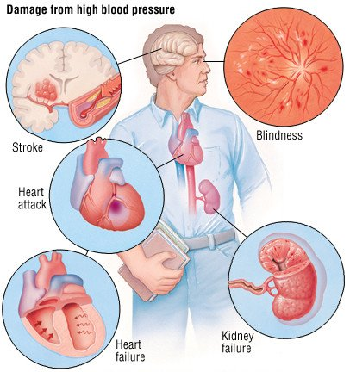

Slide 19
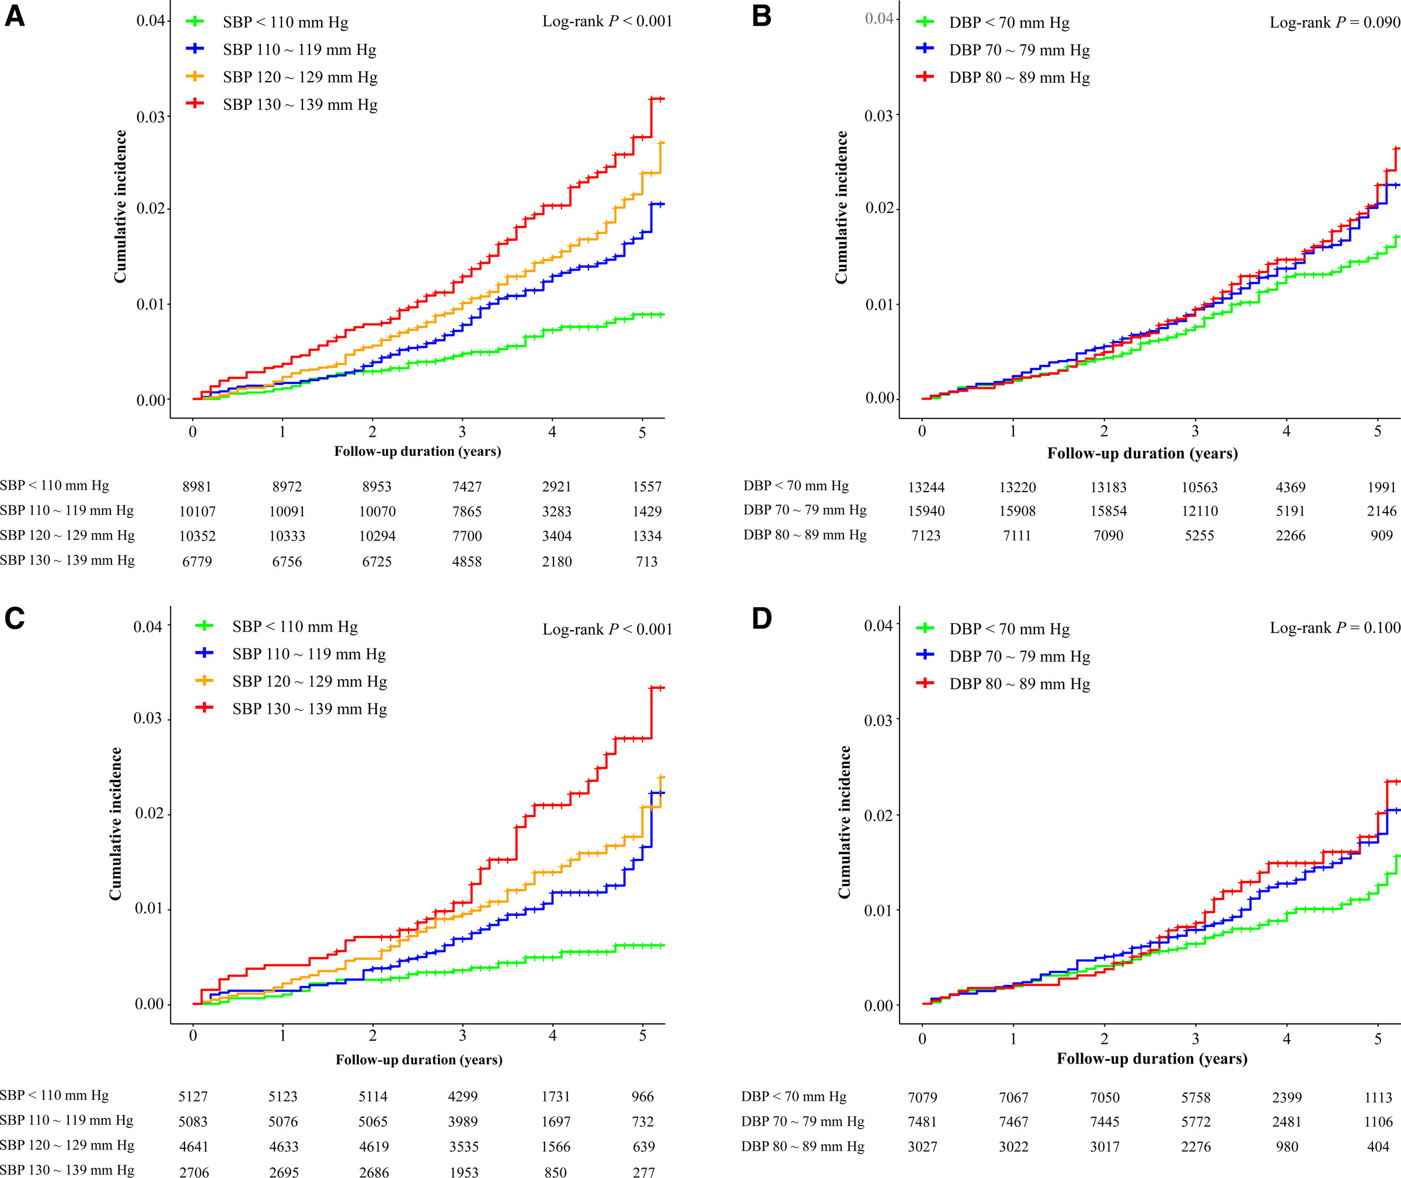

Slide 20
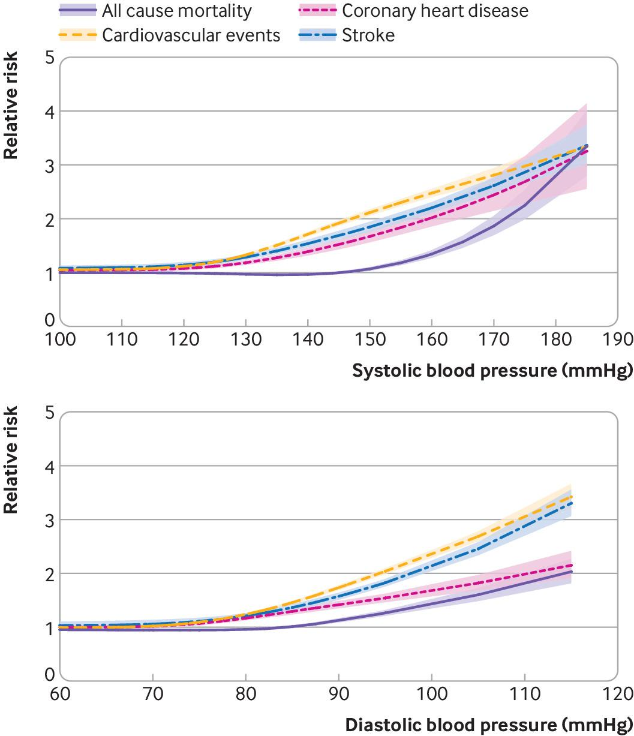

Slide 21
Observational studies have demonstrated graded associations between higher systolic blood pressure (SBP) and diastolic blood pressure (DBP) and increased CVD risk.
In a meta-analysis of 61 prospective studies, the risk of CVD increased in a log-linear fashion from SBP levels <115 mm Hg to >180 mm Hg and from DBP levels <75 mm Hg to >105 mm Hg.
In that analysis, 20 mm Hg higher SBP and 10 mm Hg higher DBP were each associated with a doubling in the risk of death from stroke, heart disease, or other vascular disease.

Slide 22
In an observational study including >1 million adult patients 30 years of age, higher SBP and DBP were associated with increased risk of CVD incidence and angina, myocardial infarction (MI), HF, stroke, peripheral artery disease (PAD), and abdominal aortic aneurysm, each evaluated separately

Slide 23
۲- فشارخون بالا شیوع بالایی دارد.

Slide 24
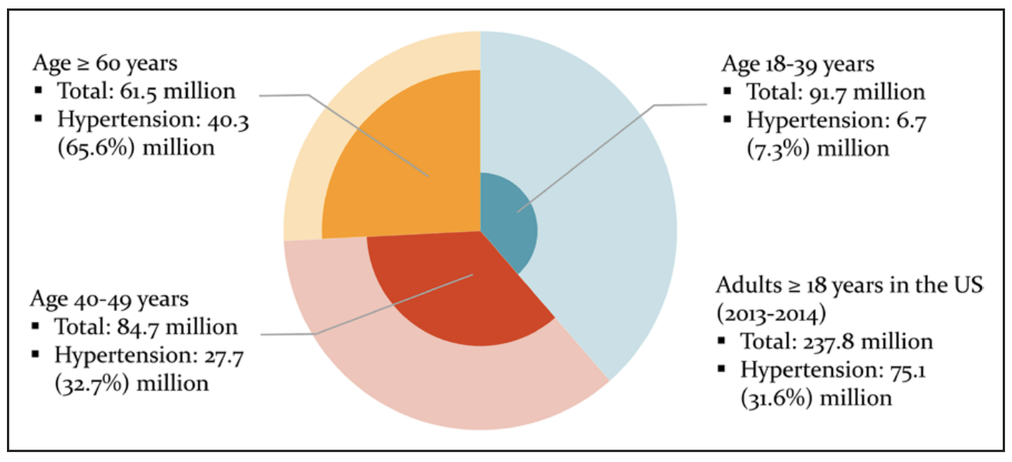

Slide 25
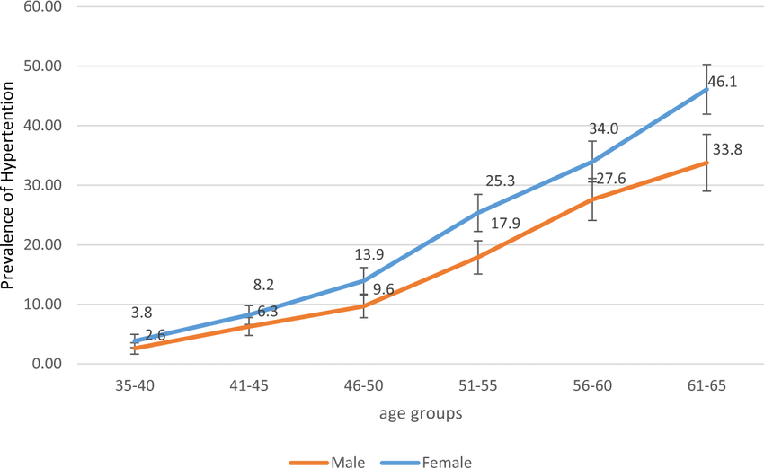

Slide 26
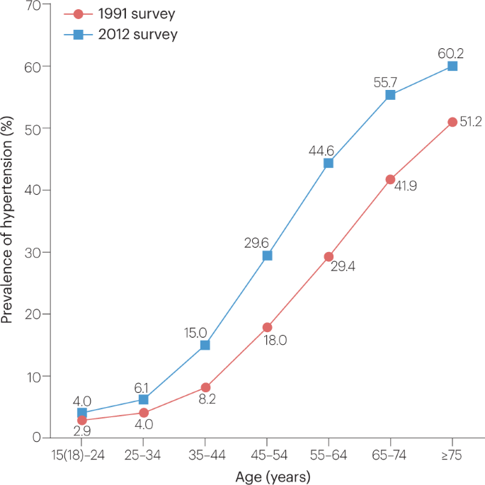

Slide 27
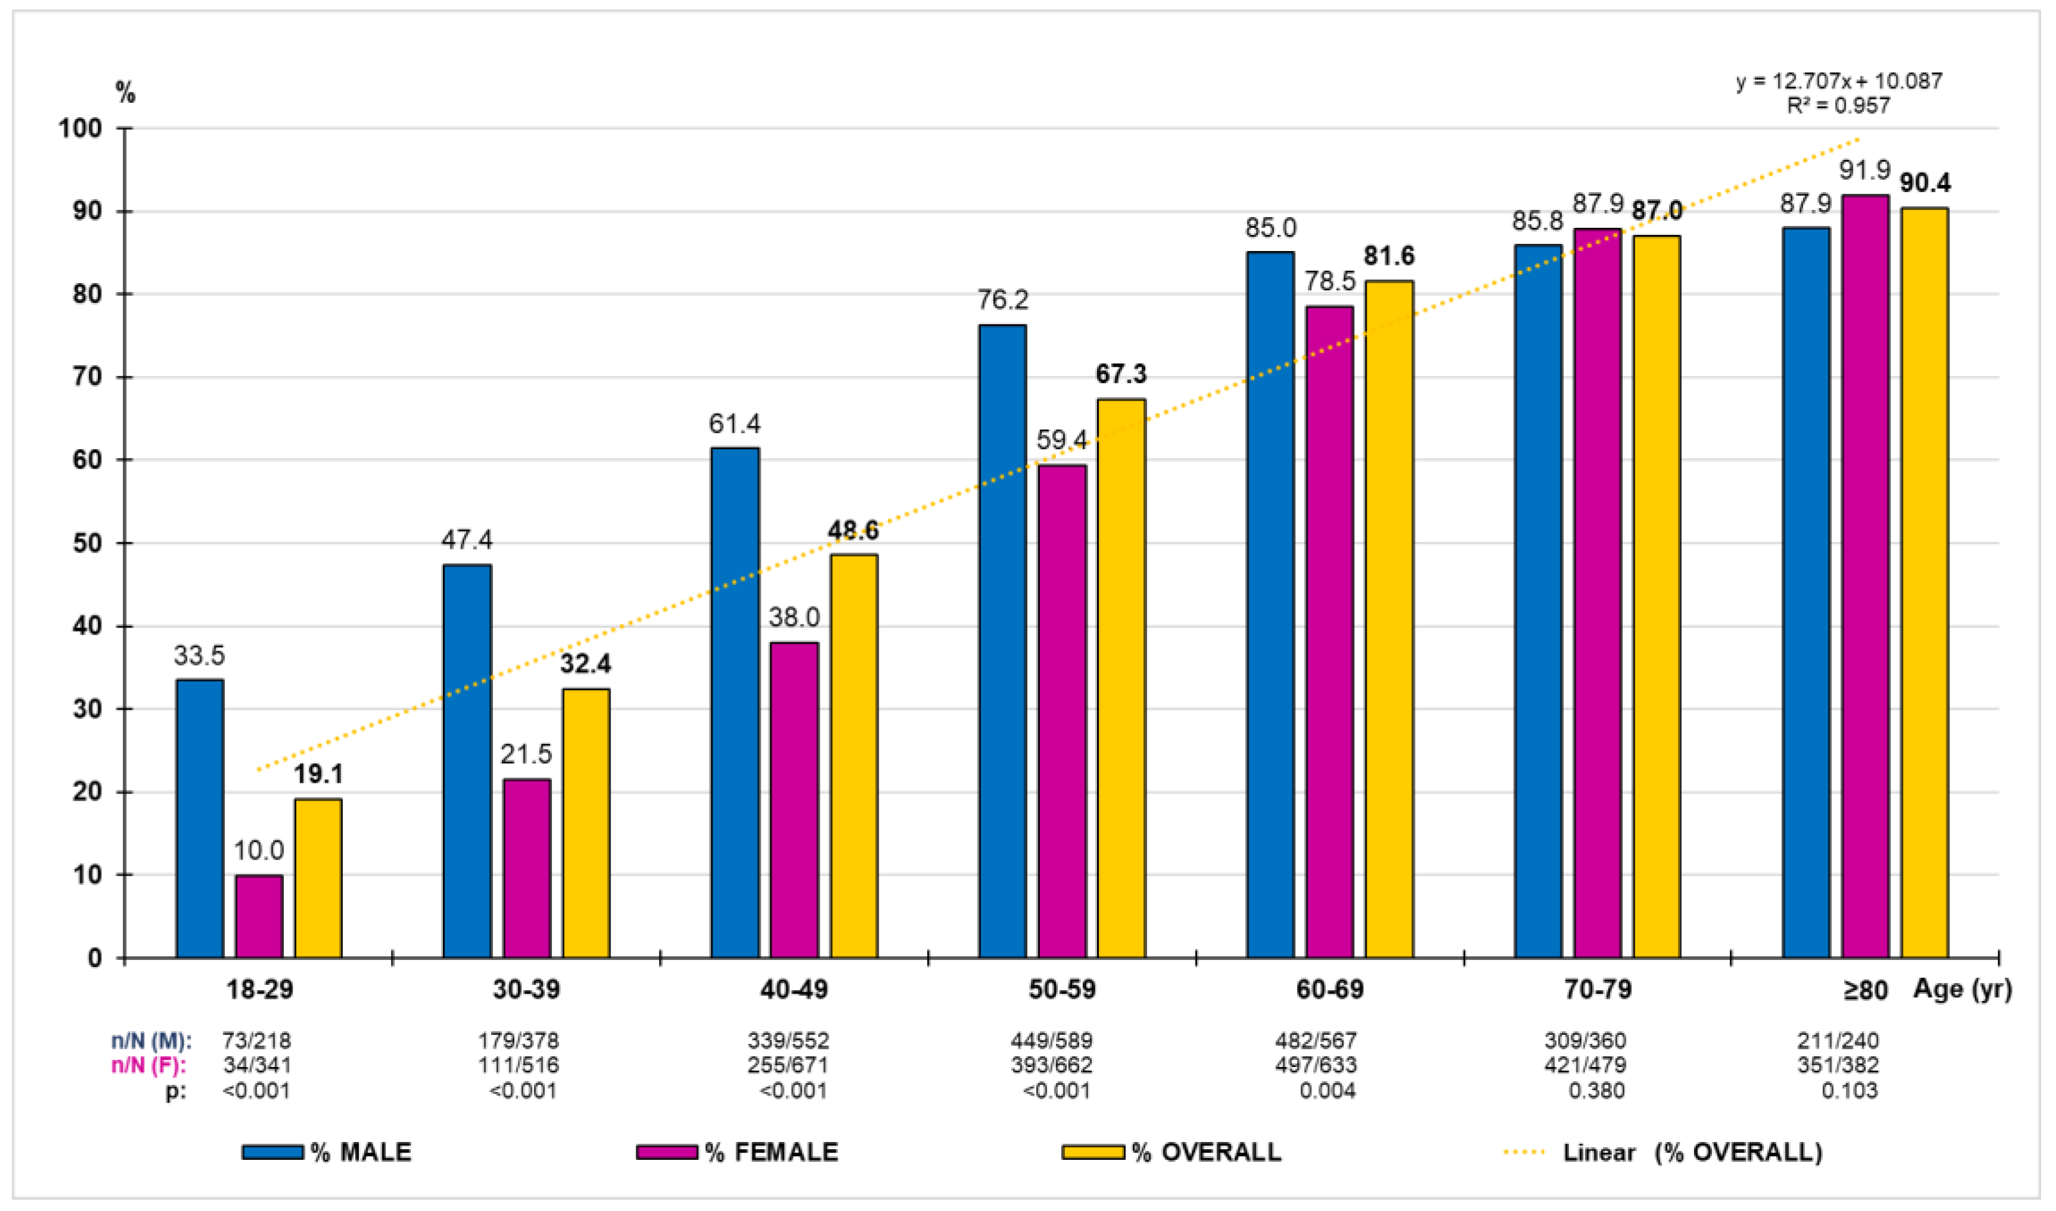

Slide 28
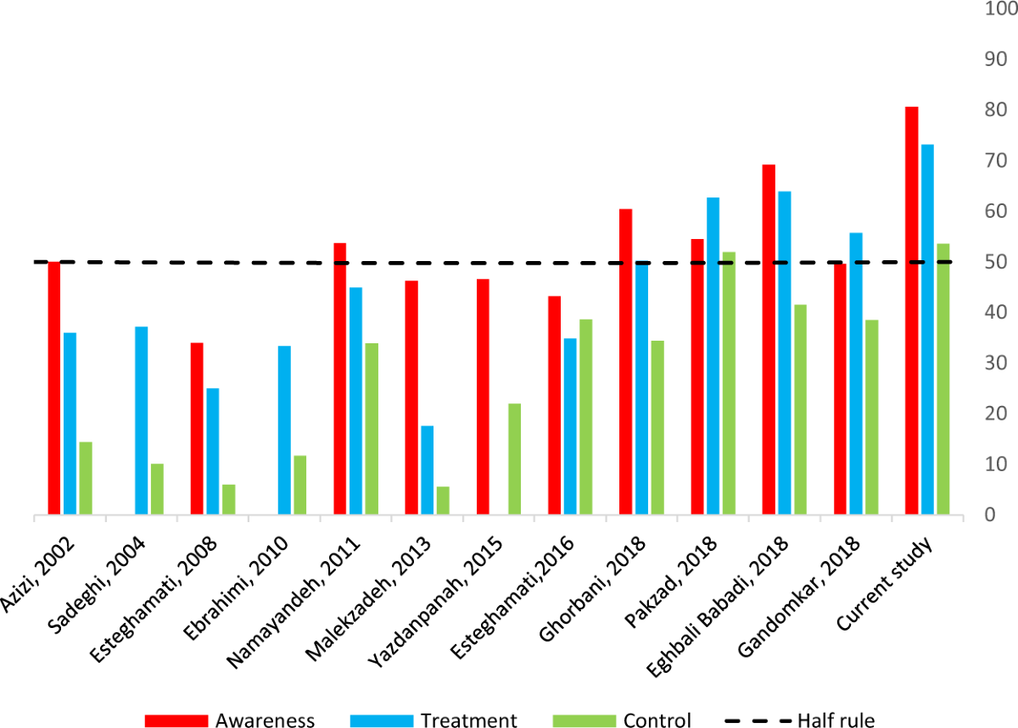
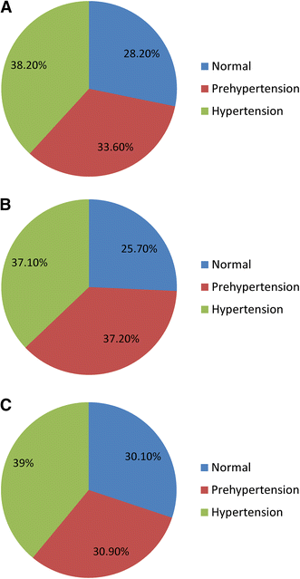

Slide 29
۳- هرچه سن شروع پایین تر، عوارض بیشتر

Slide 30
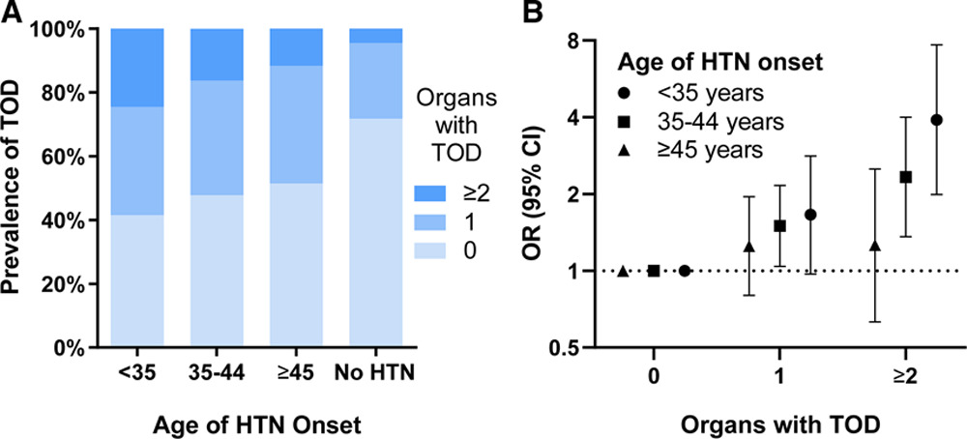

Slide 31
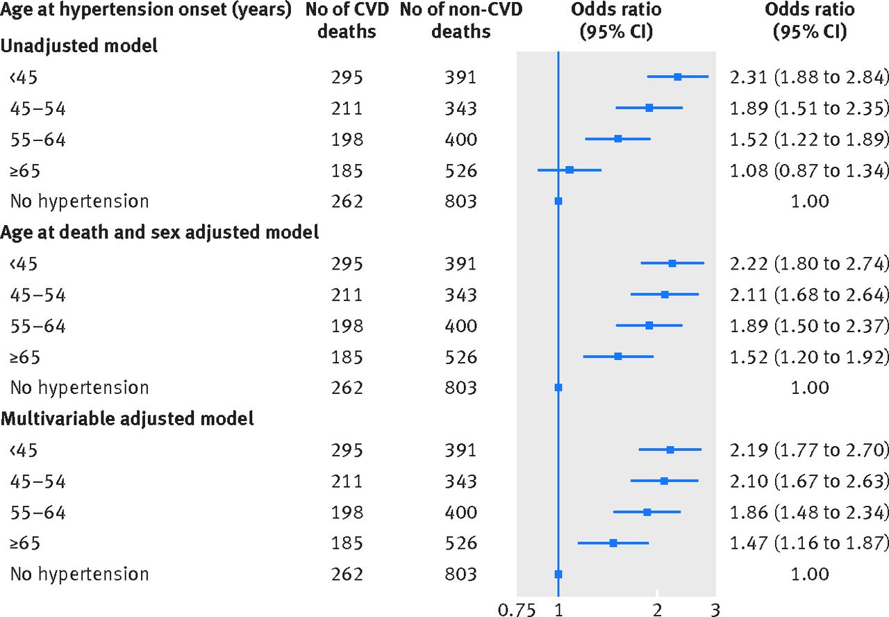

Slide 32
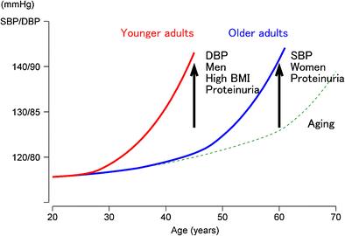

Slide 33
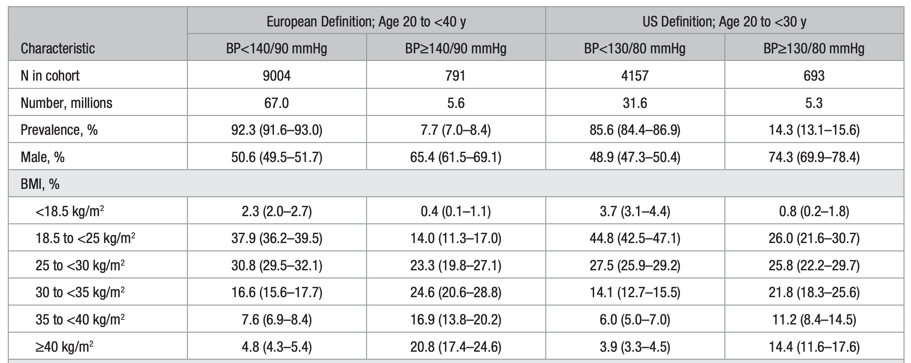

Slide 34
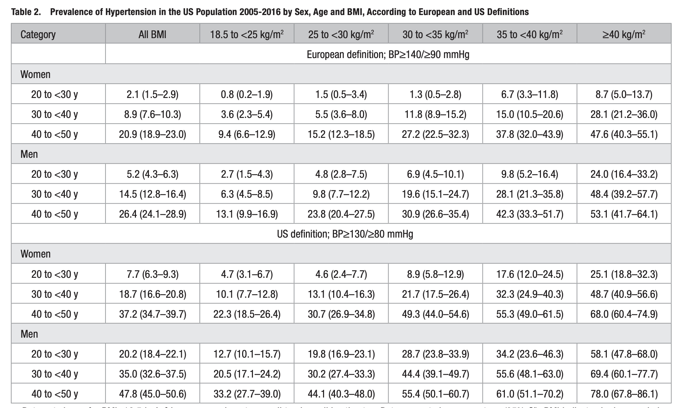

Slide 35
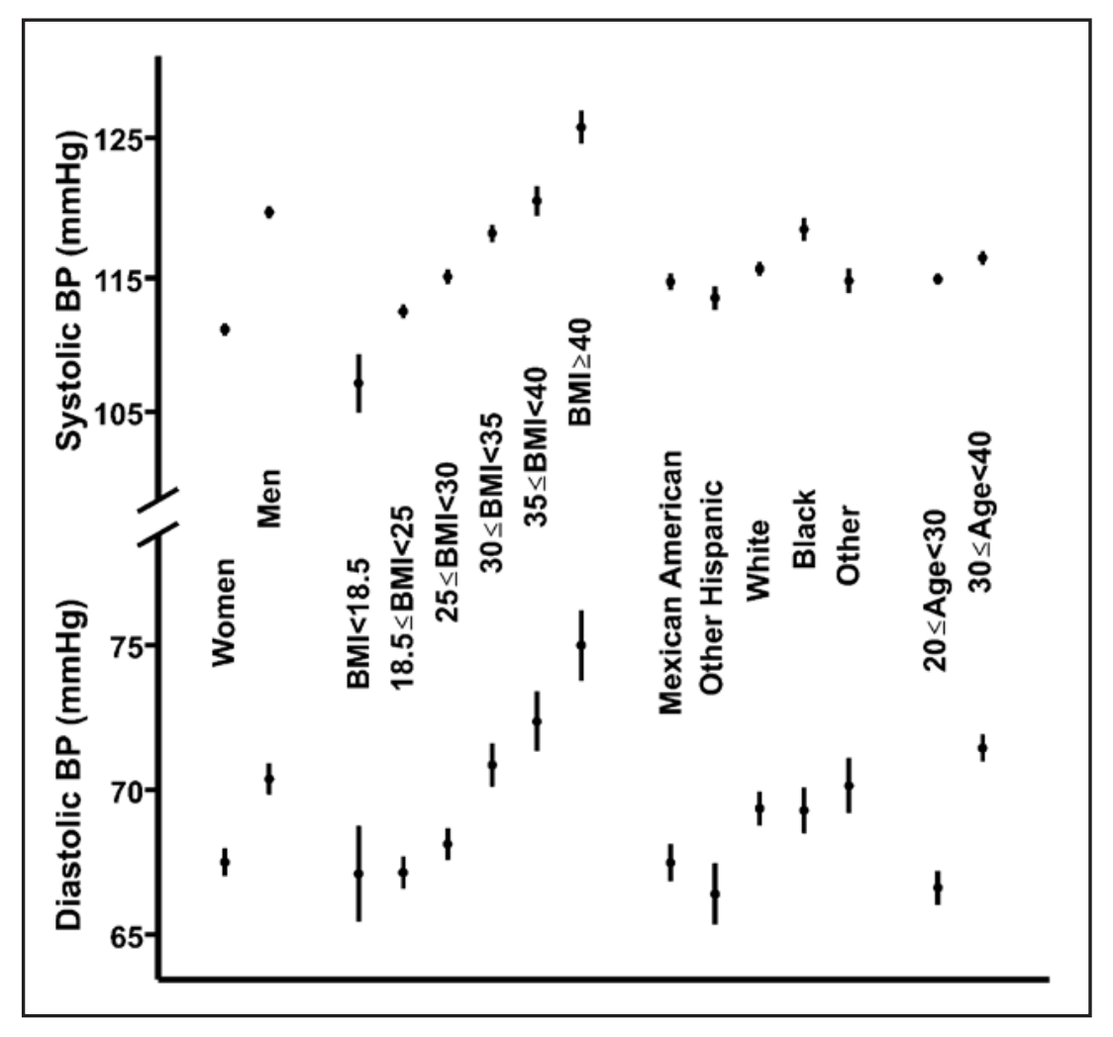

Slide 36
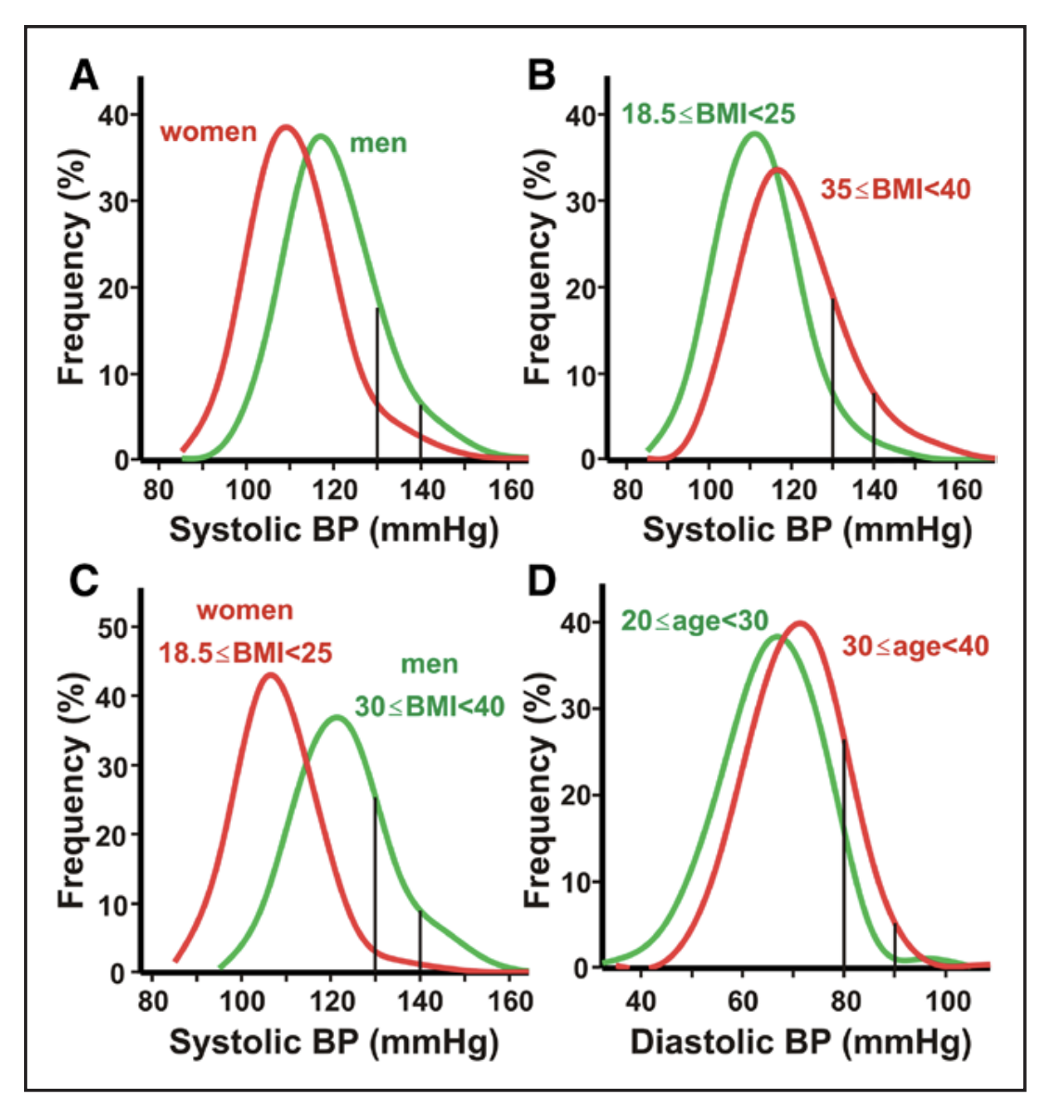

Slide 37
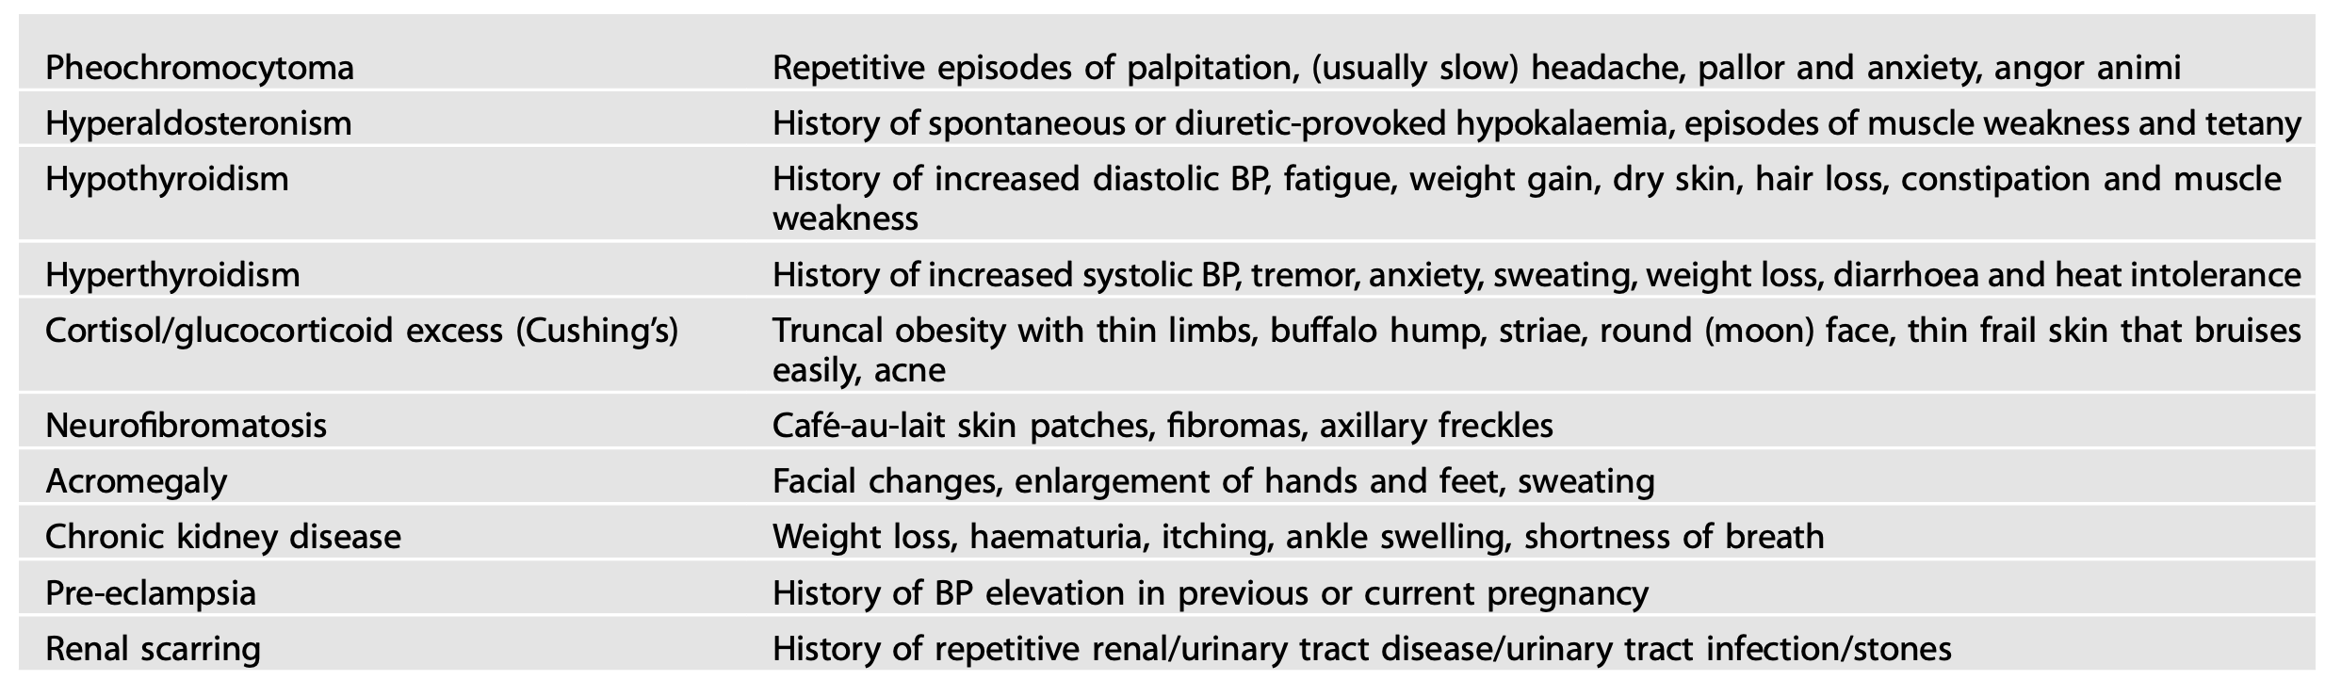

Slide 38
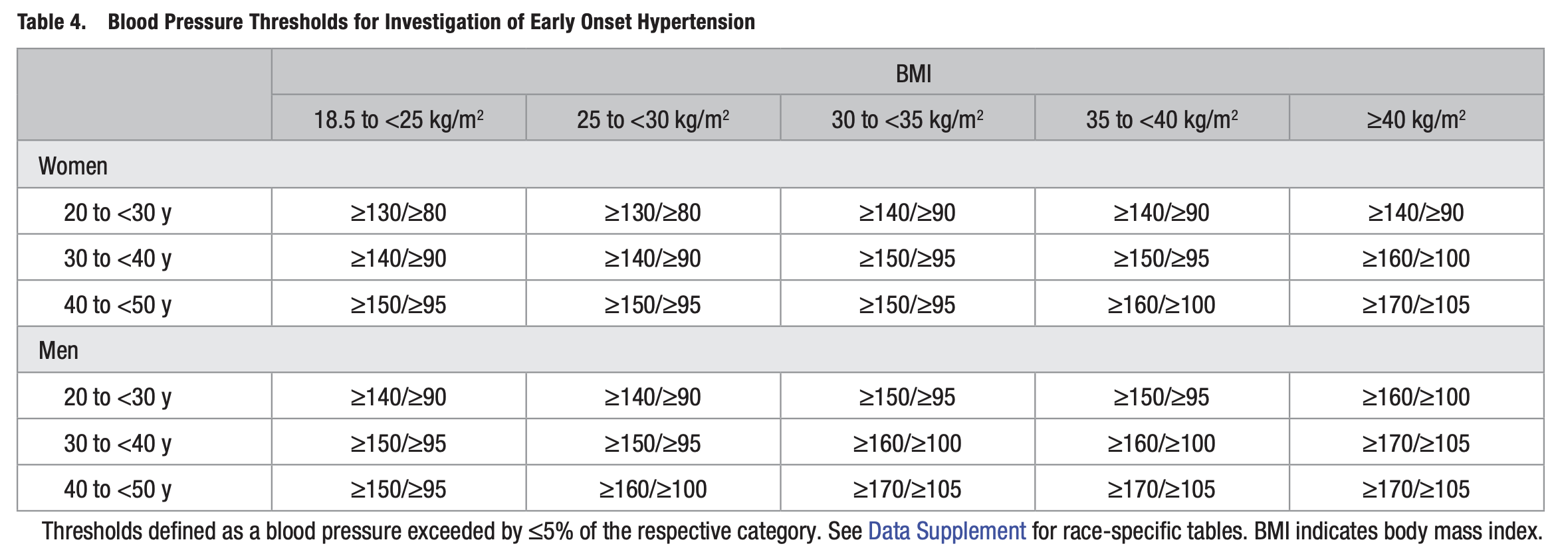

Slide 39
افراد جوان و با اضافه وزن و چاق

Slide 40
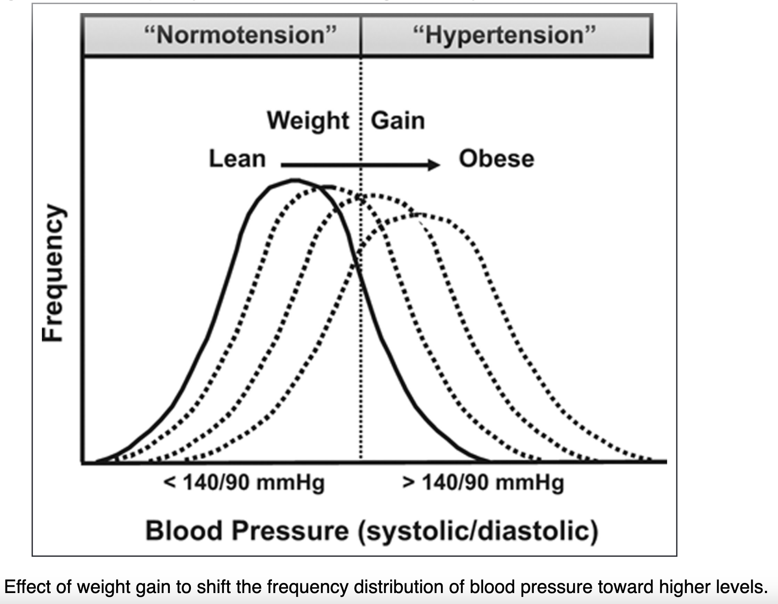

Slide 41
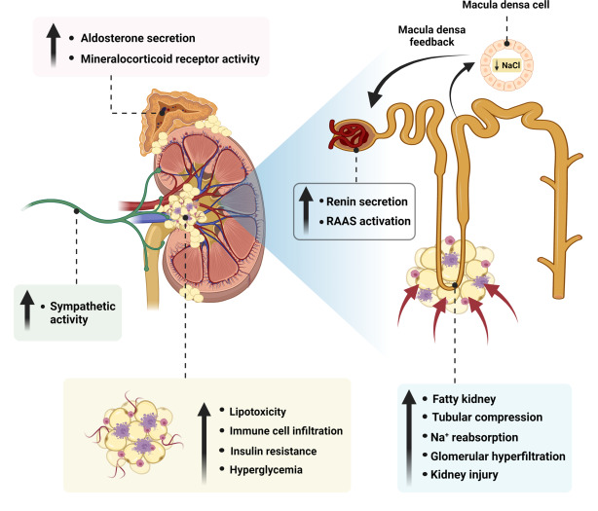

Slide 42
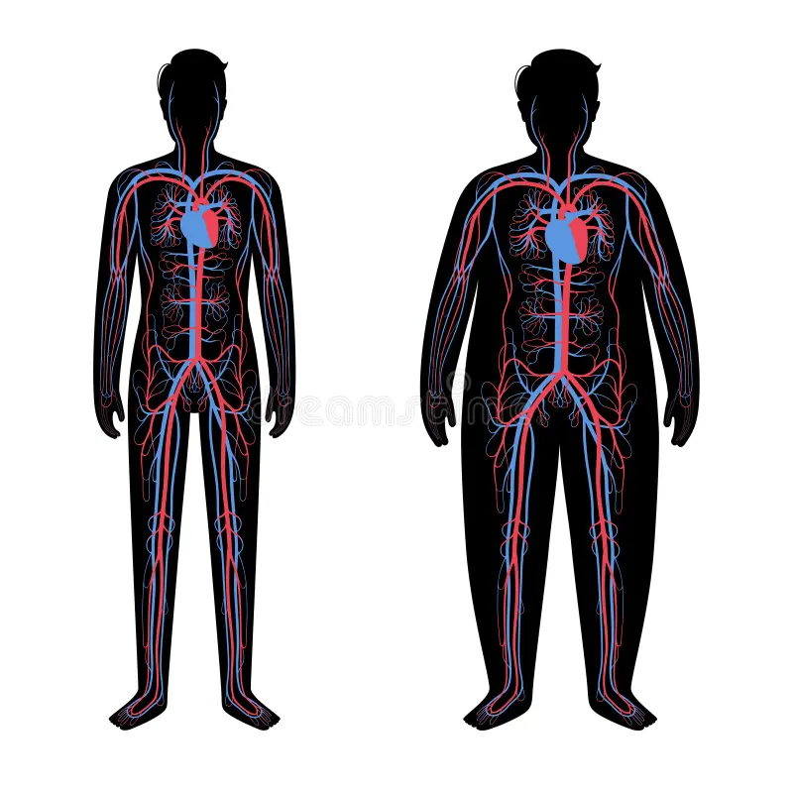

Slide 43
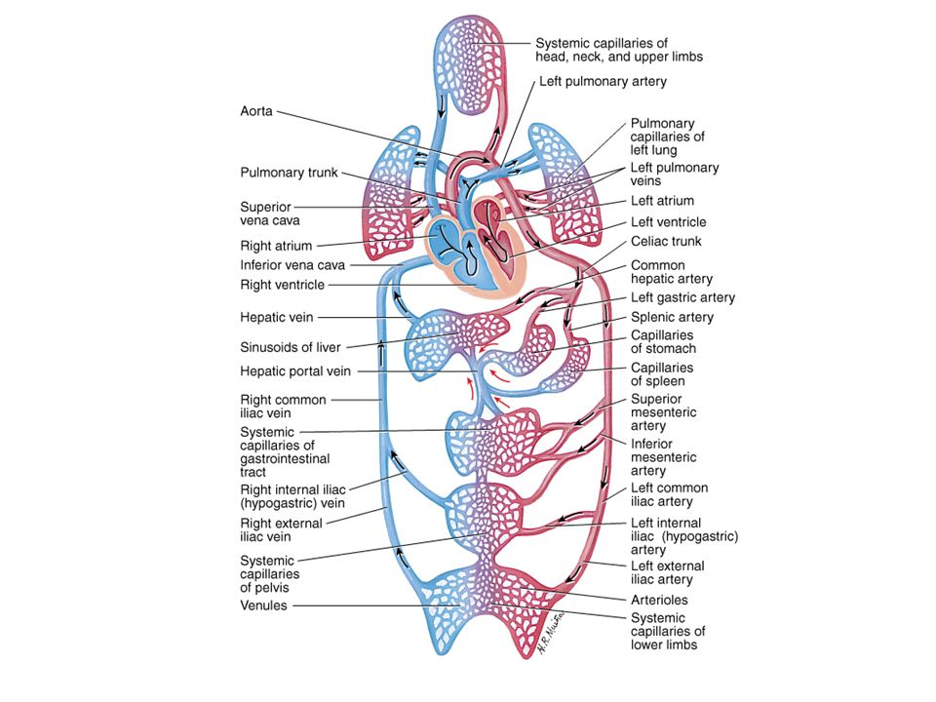
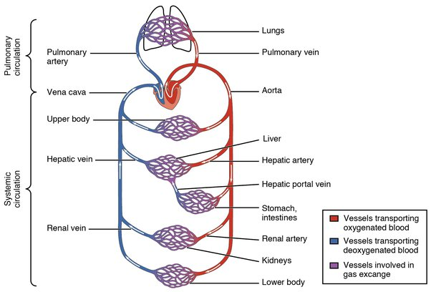

Slide 44
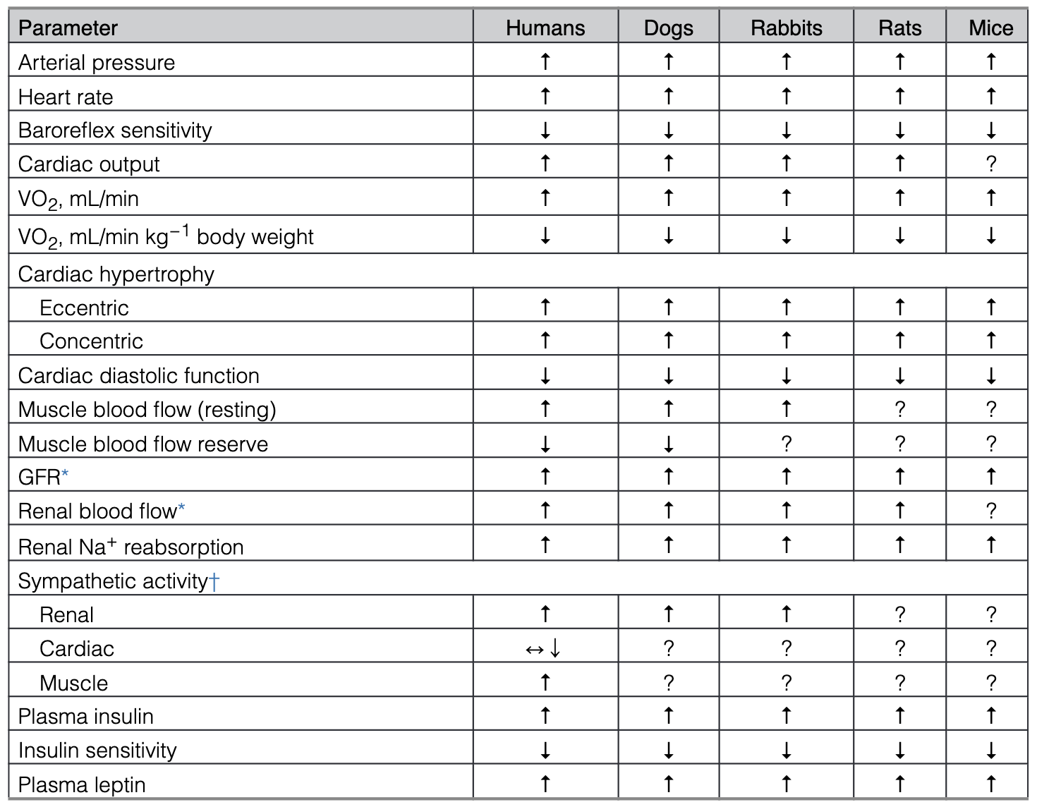

Slide 45
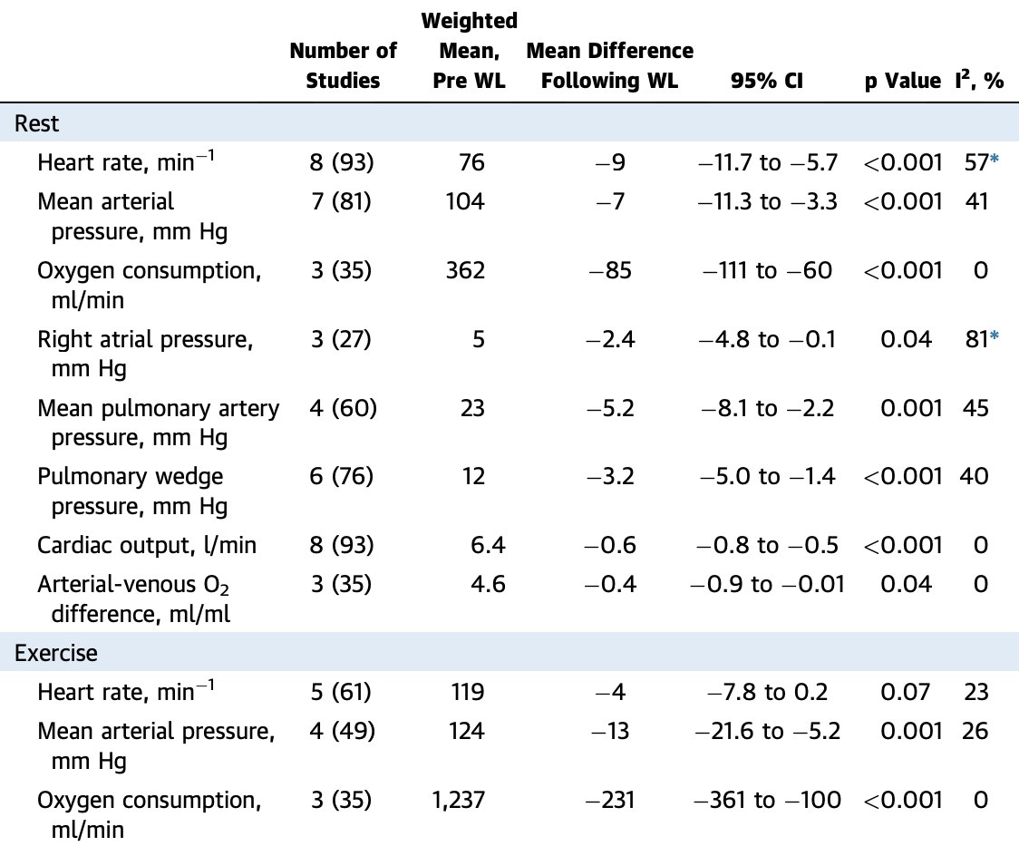

Slide 46
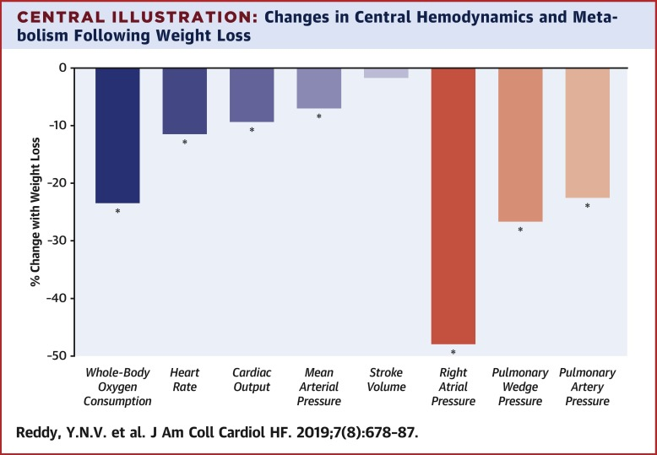

Slide 47
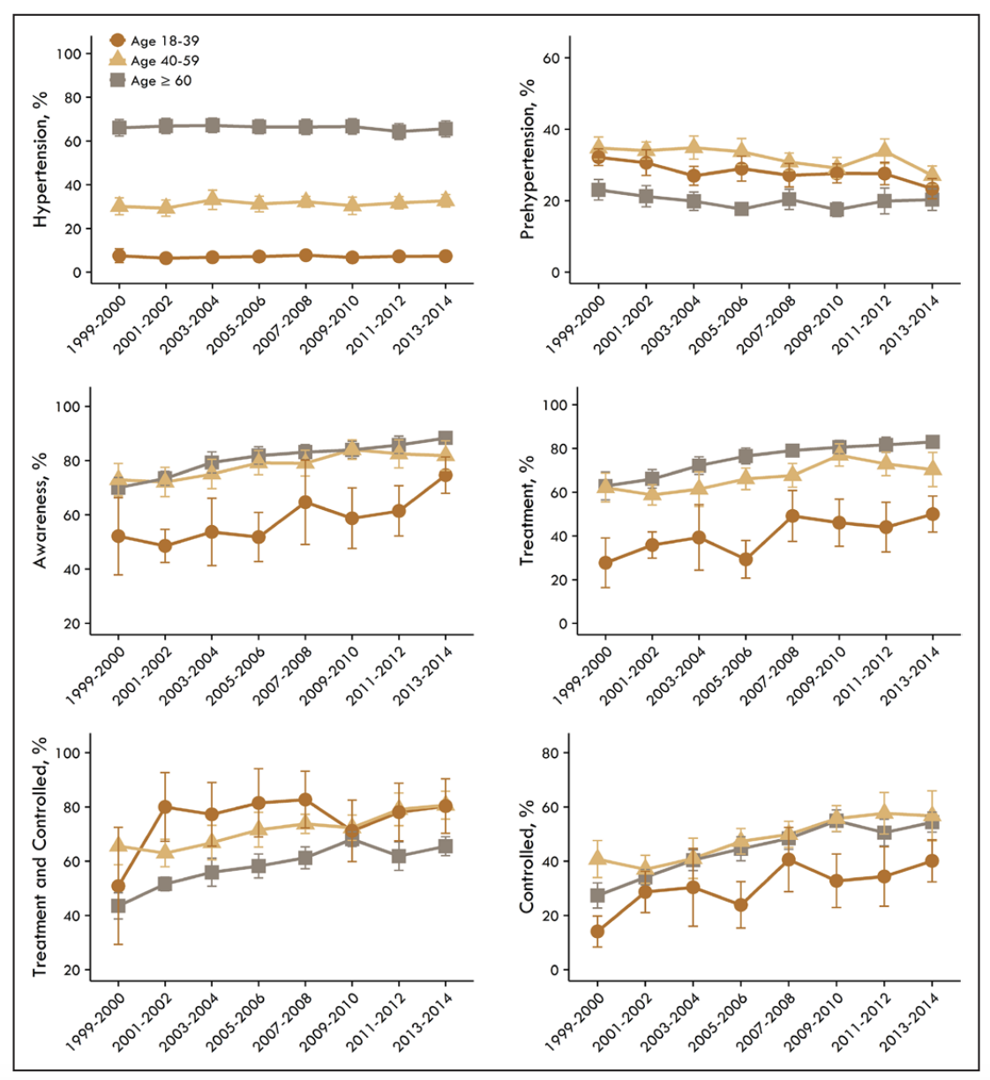

Slide 48
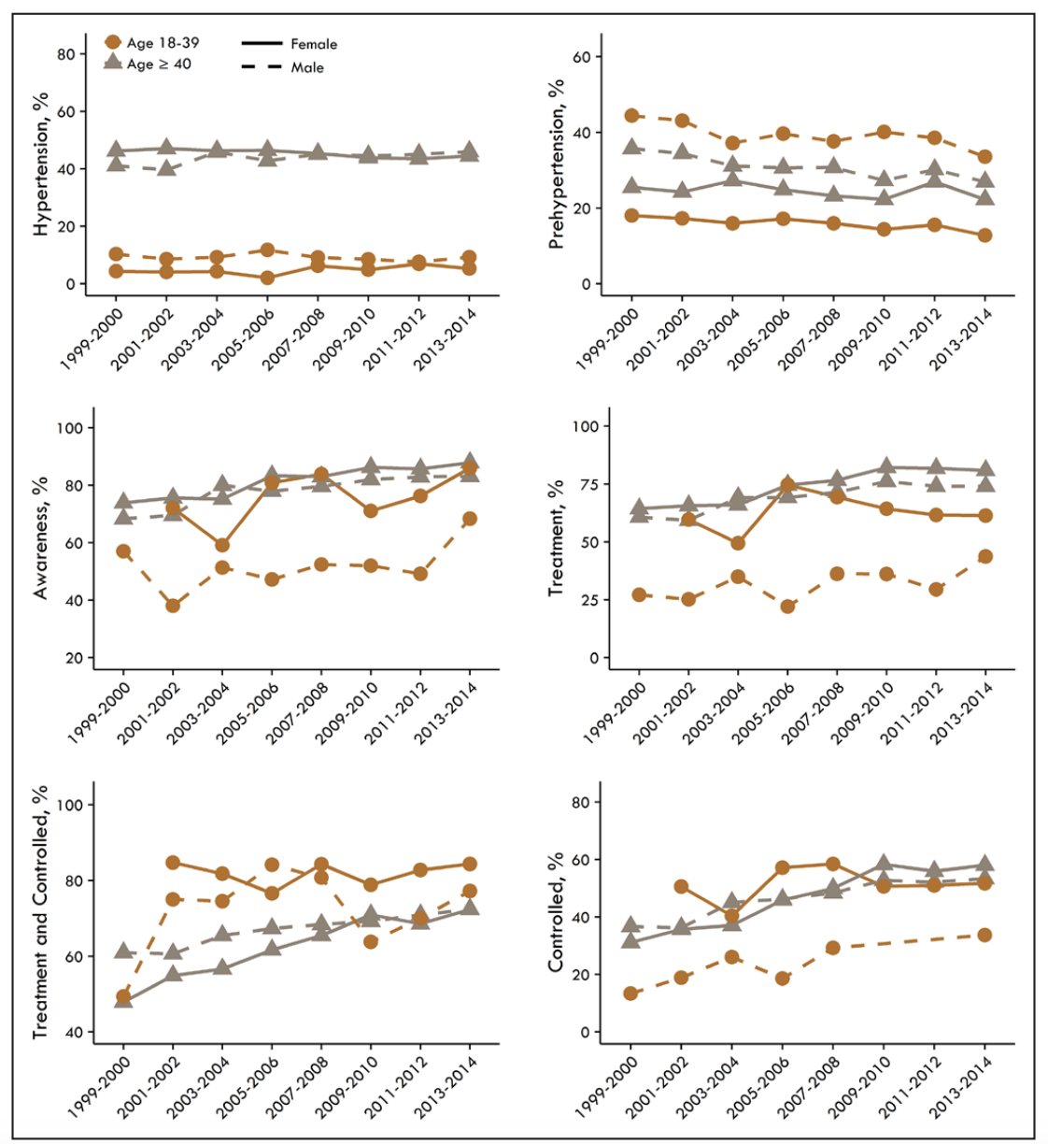

Slide 49
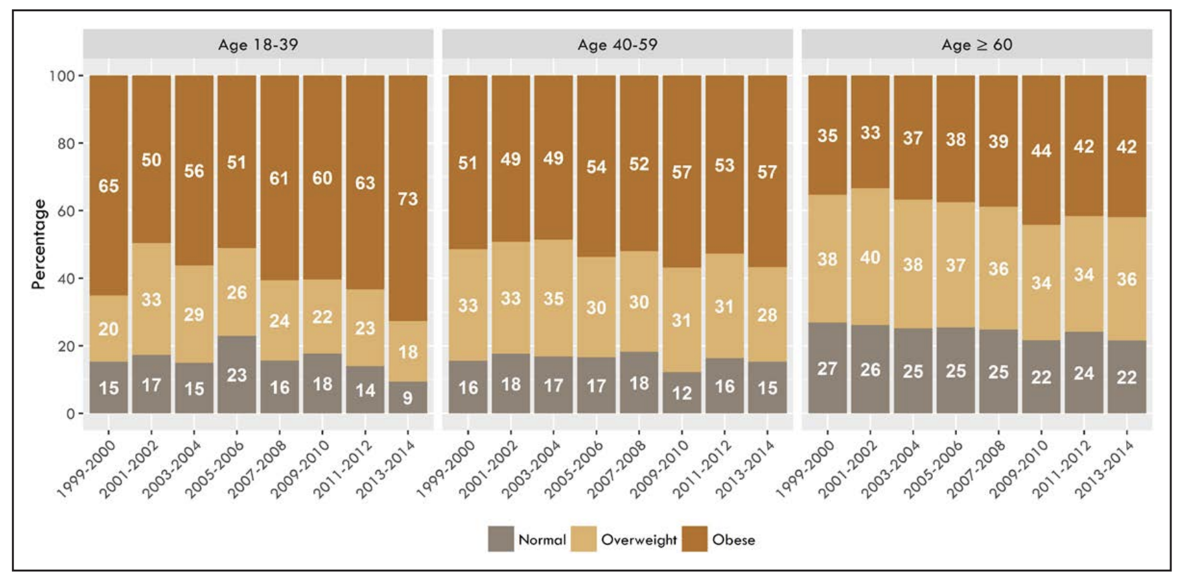

Slide 50
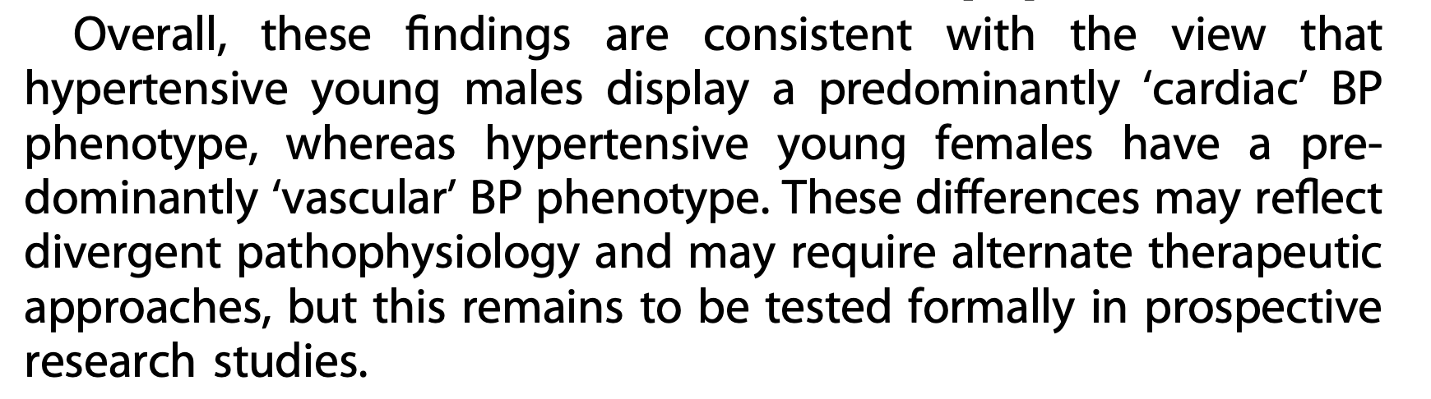

Slide 51
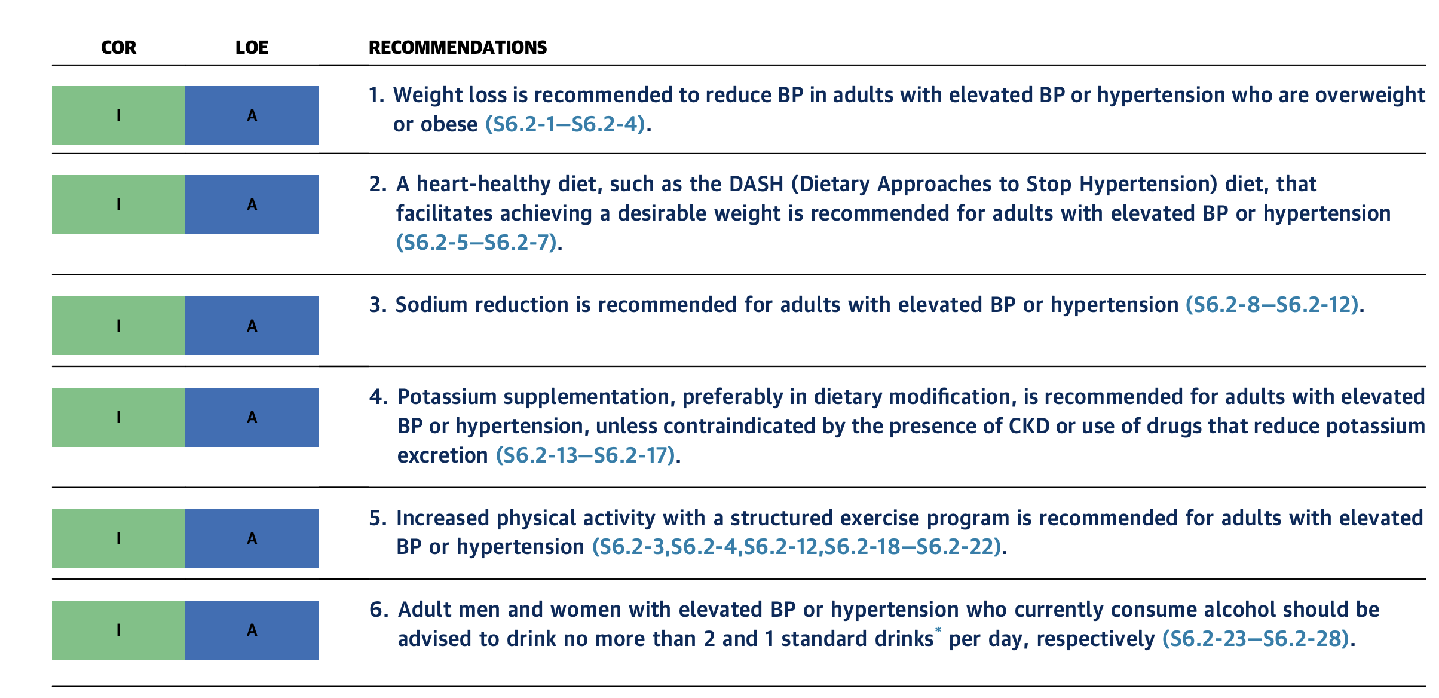

Slide 52


Slide 53
Prevention and education

Slide 54
Epidemiological studies have demonstrated an inverse relationship between physical activity and physical fitness and level of BP and hypertension.
Even modest levels of physical activity have been associated with a decrease in the risk of incident hypertension
Physical fitness, measured objectively by graded exercise testing, attenuates the rise of BP with age and prevents the development of hypertension.
In the CARDIA (Coronary Artery Risk Development in Young Adults) study, physical fitness measured at 18 to 30 years of age in the upper 2 deciles of an otherwise healthy population was associated with one third the risk of developing hypertension 15 years later, and one half the risk after adjustment for body mass index, as compared with the lowest quintile.
In a cohort of men 20 to 90 years of age who were followed longitudinally for 3 to 28 years, higher physical fitness decreased the rate of rise in SBP over time and delayed the time to onset of hypertension

Slide 57
Epidemiological studies, including the Framingham Heart Study and the Nurses’ Health Study, have consistently identified a direct relationship between body mass index and BP that is continuous and almost linear, with no evidence of a threshold.
The relationship with BP is even stronger for waist-to-hip ratio and computed tomographic measures of central fat distribution.
Attributable risk estimates from the Nurses’ Health Study suggest that obesity may be responsible for about 40% of hypertension, and in the Framingham Offspring Study, the corresponding estimates were even higher (78% in men and 65% in women)
The relationship between obesity at a young age and change in obesity status over time is strongly related to future risk of hypertension. In combined data from 4 longitudinal studies begun in adolescence with repeat examination in young adulthood to early middle age, being obese continuously or acquiring obesity was associated with a relative risk of 2.7 for developing hypertension. Becoming normal weight reduced the risk of developing hypertension to a level similar to those who had never been obese.

Slide 58
Obstructive sleep apnea is a common chronic condition characterized by recurrent collapse of upper airways during sleep, inducing intermittent episodes of apnea/hypopnea, hypoxemia, and sleep disruption.
Obstructive sleep apnea is a risk factor for several CVDs, including hypertension, coronary and cerebrovascular diseases, HF, and AF (S5.4.4-6—S5.4.4-9). Observational studies have shown that the presence of obstructive sleep apnea is associated with increased risk of incident hypertension

Slide 59
Nonpharmacological interventions are effective in lowering BP, with the most important interventions being weight loss (S6.2-1), the DASH (Dietary Approaches to Stop Hypertension) diet (S6.2-5—S6.2-7,S6.2-30), sodium reduction (S6.2-8—S6.2-12), potassium supplementation (S6.2-13,S6.2-17), increased physical activity (S6.2-18— S6.2-22,S6.2-31), and a reduction in alcohol consumption (S6.2-23,S6.2-24).
Various other nonpharmacological interventions have been reported to lower BP, but the extent and/or quality of the supporting clinical trial experience is less persuasive. Such interventions include consumption of probiotics (S6.2-32,S6.2-33,S6.2-34); increased intake of protein (S6.2-35—S6.2-37), fiber (S6.2-38,S6.2-39), flaxseed (S6.2-40), or fish oil (S6.2-41); supplementation with calcium (S6.2-42,S6.2-43) or magnesium (S6.2-44,S6.2-45); and use of dietary patterns other than the DASH diet, including low-carbohydrate, vegetarian, and Mediterranean diets (S6.2-46—S6.2-49). S

Slide 60
Stress reduction is intuitively attractive but insufficiently proved (S6.2-51), as are several other interventions, including consumption of garlic (S6.2-52), dark chocolate (S6.2-53,S6.2-54), tea (S6.2- 55), or coffee (S6.2-56).
Behavioral therapies, including guided breathing, yoga, transcendental meditation, and biofeedback, lack strong evidence for their long-term BPlowering effect (S6.2-51,S6.2-57—S6.2-61).

Slide 61
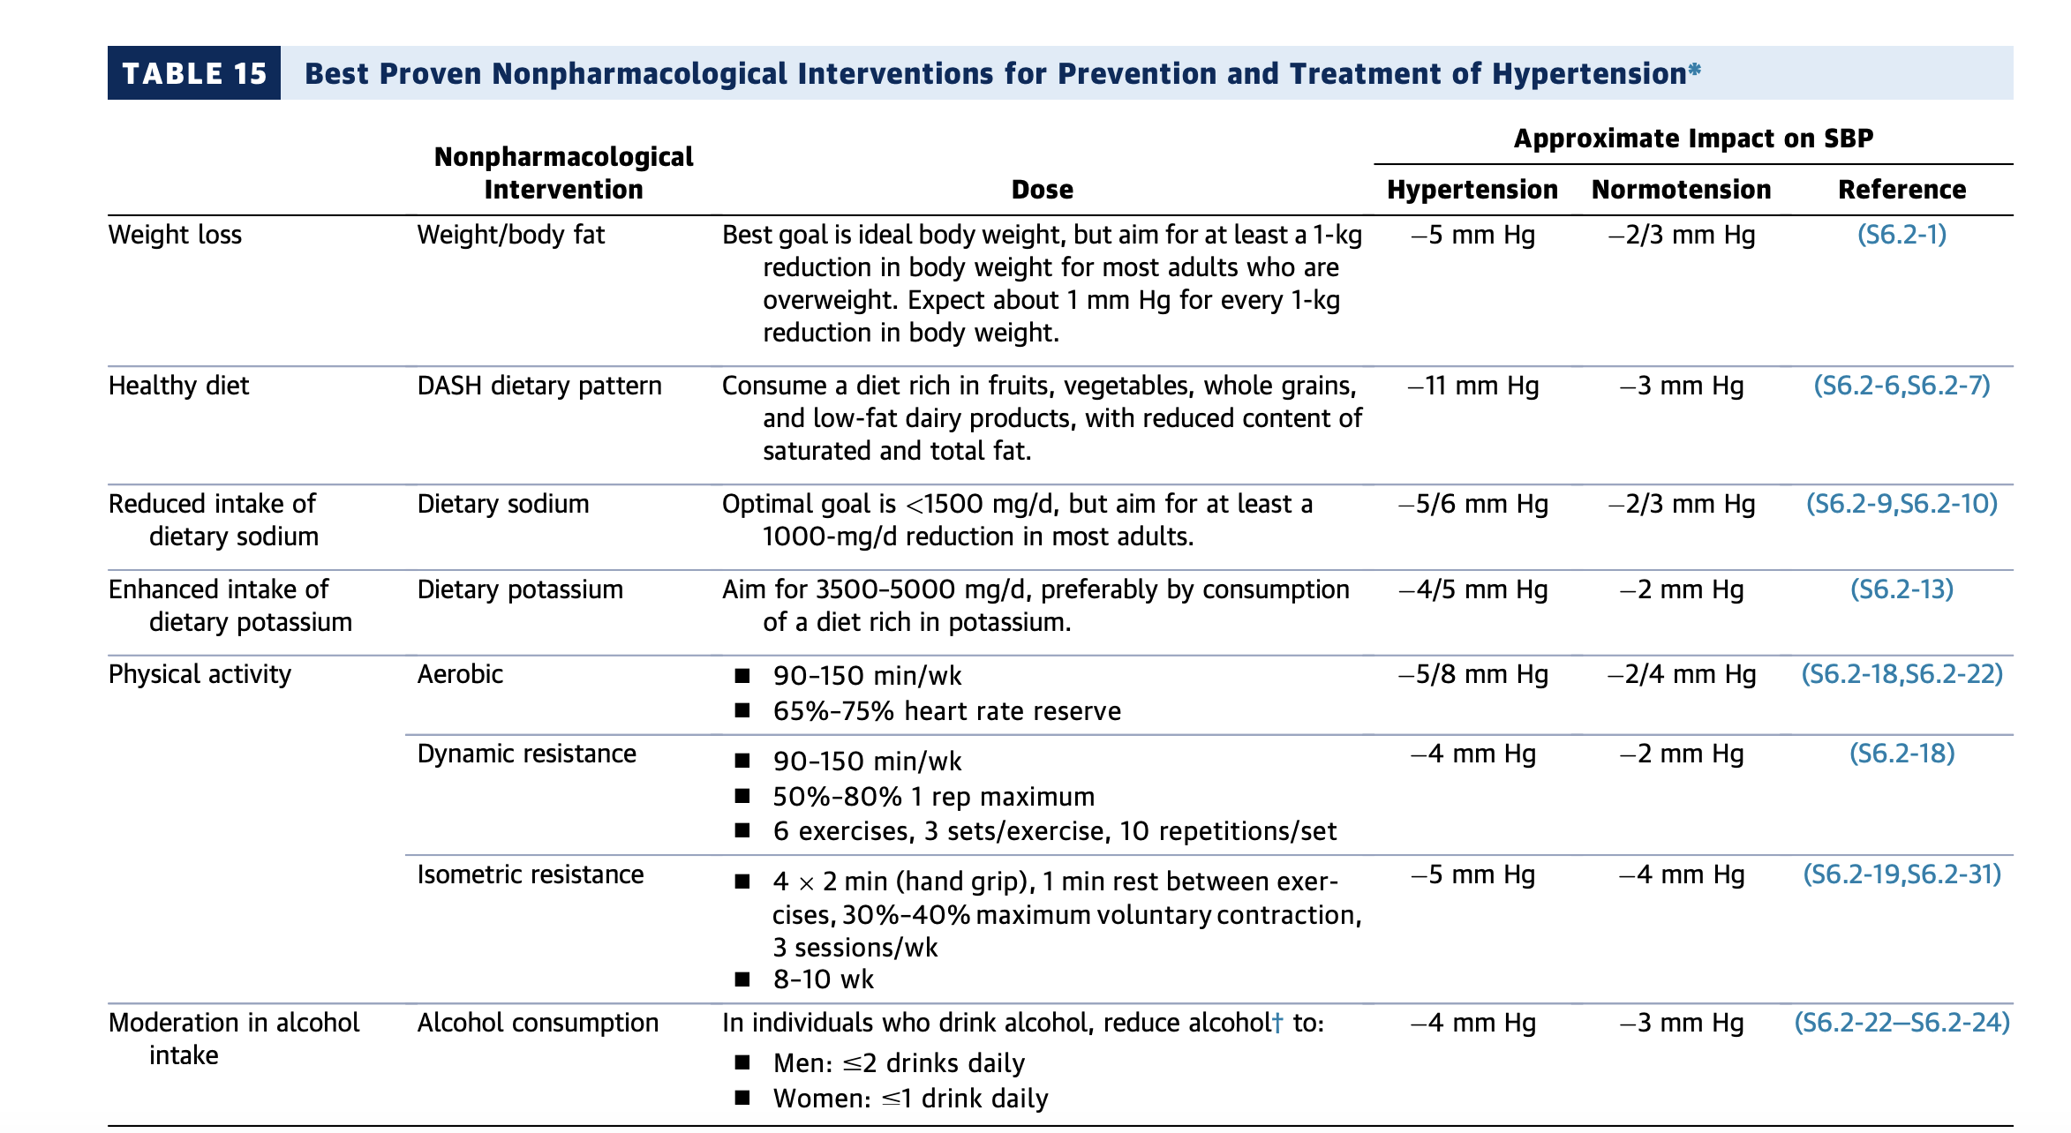

Slide 62
The nonpharmacological interventions presented in Table 15 may be sufficient to prevent hypertension and meet goal BP in managing patients with stage 1 hypertension, and they are an integral part of the management of persons with stage 2 hypertension. To a lesser extent, the Mediterranean diet (S6.2-49,S6.2-63) (which incorporates the basics of healthy eating but emphasizes consumption of legumes and monounsaturated fat, avoidance of red meats, and moderate intake of wine) has been effective in reducing BP, as well as improving lipid profile.

Slide 65
balancing caloric intake with caloric expenditure.
participate in comprehensive lifestyle programs of $6 months’ duration
adhering to a low-calorie diet (800 to 1,500 kcal/day) and increased physical activity
Existing clinical guidance strongly recommends face-to-face or telephone-delivered weight-loss maintenance programs that provide regular contact (at least monthly)
engage in high levels of physical activity JACC VOL. 74, NO. 10, 2019 Arnett et al. SEPTEMBER 10, 2019:e177 – 232 2019 ACC/AHA Guideline on the Primary Prevention of Cardiovascular Disease e191 (200 to 300 minutes/week), monitor body weight regularly (at least weekly), and consume a reduced-calorie diet

Slide 66
U.S. Food and Drug Administration (FDA)–approved pharmacological therapies (S4.1-1, S4.1-11) and bariatric surgery (S4.1-12), adjunctive to complementary lifestyle interventions, additionally reduce weight and may have a role in weight loss for select patients.
Weight loss interventions should be cautiously implemented and individualized, especially in older adults, to avoid detrimental effects, such as loss of lean body/muscle mass and nutritional deficiencies (S4.1-13–S4.1-15).

Slide 67
Clinically meaningful weight loss ($5% initial weight) is associated with moderate improvement in BP, lowdensity lipoprotein cholesterol (LDL-C), triglyceride, and glucose levels among individuals with overweight/ obesity (S4.1-1). Weight loss reduces or delays the development of T2DM in persons with obesity (S4.1-1, S4.1-16, S4.1-17).
High-intensity ($14 sessions in 6 months) comprehensive weight-loss interventions provided by a trained interventionist work best (S4.1-10). However, other modalities, such as electronically delivered weight-loss programs with personalized feedback and some commercial-based programs, have also shown moderate results.

Slide 68
Comprehensive lifestyle intervention consists of a structured program, which includes regular selfmonitoring of food intake, physical activity, and weight.
Increased physical activity, preferably aerobic physical activity (e.g., brisk walking) for $150 minutes/ week (equal to $30 minutes/day on most days of the week), is recommended for initial weight loss
Higher levels of physical activity, approximately 200 to 300 minutes/week, are recommended to maintain weight loss or minimize weight regain after 1 year.
Adults with obesity are also typically prescribed a diet designed to reduce caloric intake by $500 kcal/day from baseline, which often can be attained by limiting women to 1,200 to 1,500 kcal/day and men to 1,500 to 1,800 kcal/day
A very-low-calorie diet (defined as <800 kcal/day) should be prescribed only in limited circumstances and only by trained clinicians in a medical care setting with the patient under medical supervision

Slide 69
Comprehensive lifestyle intervention has been shown to produce on average 8 kg of weight loss (5% to 10% of initial body weight) in the short term (#6 months) and intermediate term (6 to 12 months), compared with usual care.
However, longer interventions after 1 year are associated with gradual weight gain of 1 or 2 kg/year (on average), compared with usual care.
Weight loss of 5% to 10% of initial weight, achieved through comprehensive lifestyle intervention, has been shown to improve BP, delay the onset of T2DM, improve glycemic control in T2DM, and improve lipid profile.

Slide 71
Measures used to estimate body fat and quantify the associated health risks include BMI, waist circumference, waist–hip ratio, bioimpedance, and dual-energy X-ray absorptiometry (DXA) (S4.1-18). BMI, waist circumference, and waist–hip ratio are easily measured and therefore are the most widely used in clinical practice.
A USPSTF document found good evidence supporting the use of BMI to identify adults at increased risk of future morbidity and mortality (S4.1-18). Because obesity/overweight defined by BMI is the most studied and standardized approach, we recommend its measurement for primary screening of individuals needing weight loss.
BMI should be interpreted with caution in persons of Asian ancestry, older adults, and muscular adults

Slide 72
Increased waist circumference has been associated with increased cardiometabolic and ASCVD risk (S4.1-3– S4.1-6). Central adiposity, captured by using waist circumference, has been associated with ASCVD risk and may be missed when BMI is used as the only measure of obesity
Ethnic differences in waist circumference thresholds associated with cardiometabolic risk have been reported. Waist circumference may be more useful than BMI in persons with abdominal obesity (central adiposity)
Definitions of elevated waist circumference as $40 inches ($102 cm) in men and $35 inches ($88 cm) in women were recommended by the 1998 National Heart, Lung, and Blood Institute Obesity Initiative Expert Panel (S4.1-25) and were adopted by the 2013 AHA/ACC/TOS writing committee
Furthermore, waist circumference assessment is needed for the diagnosis of metabolic syndrome.

Slide 73
Thus, combining waist circumference and BMI may be the best approach for assessing obesity-related risk. Counseling and comprehensive lifestyle interventions, including calorie restriction and adjunctive therapies (e.g., FDA–approved drugs, bariatric surgery), have all been associated with significant reductions in waist circumference and improvement in cardiometabolic risk profiles

Slide 74
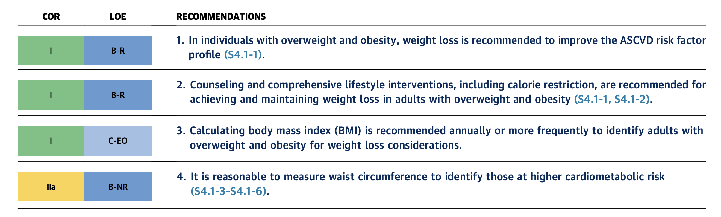

Slide 75
